Slide 1

NN basics 2

Slide 2
References
http://cs231n.stanford.edu/index.html
http://www.cs.cornell.edu/courses/cs5670/2019sp/lectures/lectures.html
http://www.cs.cmu.edu/~16385/

Slide 3
contents
Chain rule
ConvNets
Convolution layer
Pooling layer
Overfitting
Architectures
Alexnet (dropout)
VGG
ResNet (batch norm)

Slide 4
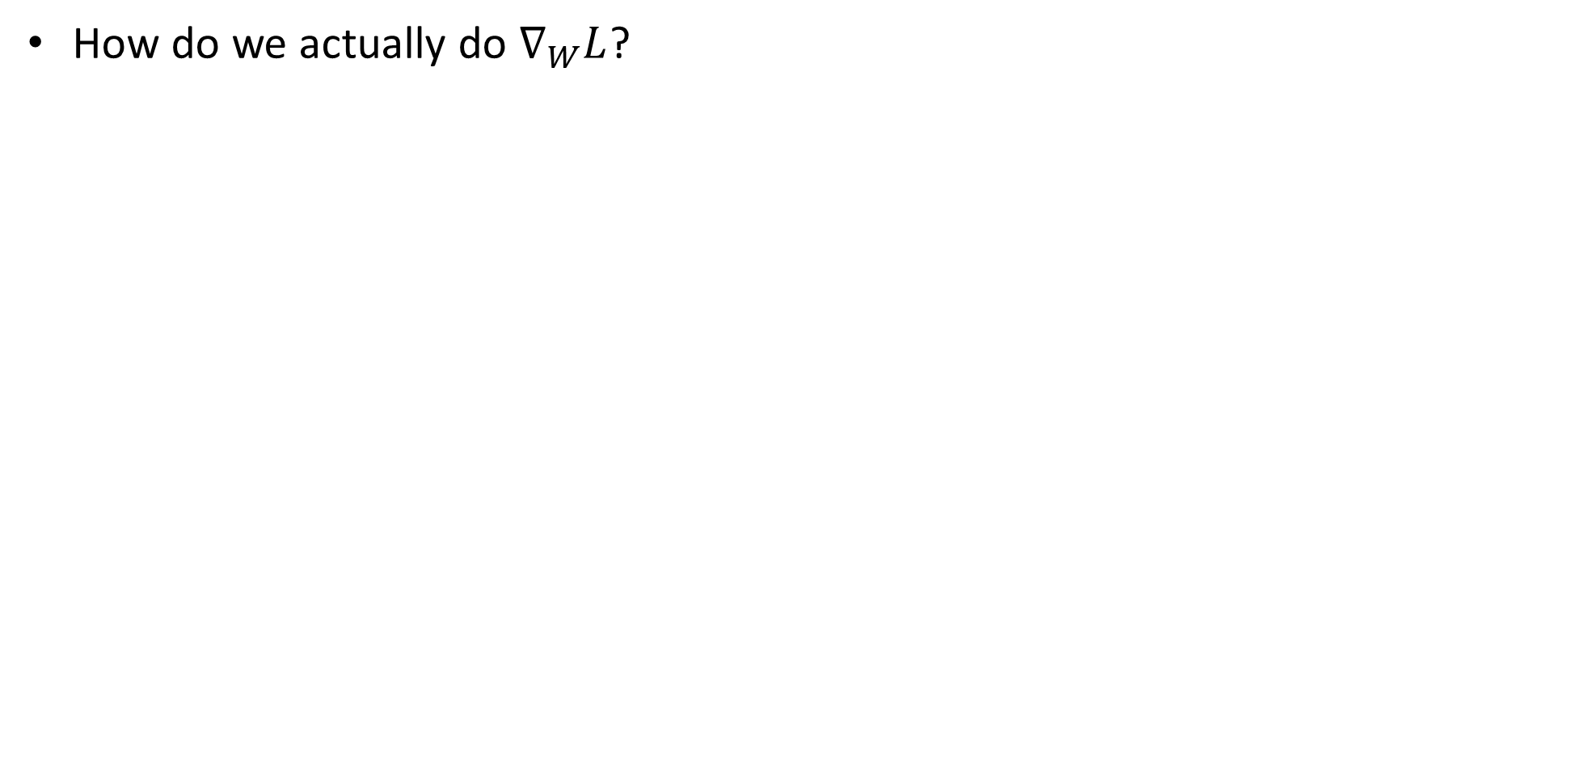
Loss derivation
How do we actually do $∇_{W}L$?

Slide 5
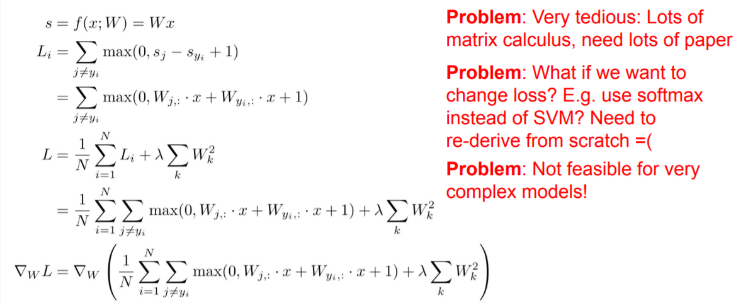
Bad idea- by hand

Slide 6
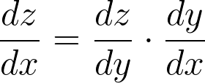
Good idea- back propagation
We are using the chain rule for gradient calculation:
Notes:
\frac{dz}{dx} = \frac{dz}{dy} \cdot \frac{dy}{dx}

Slide 7
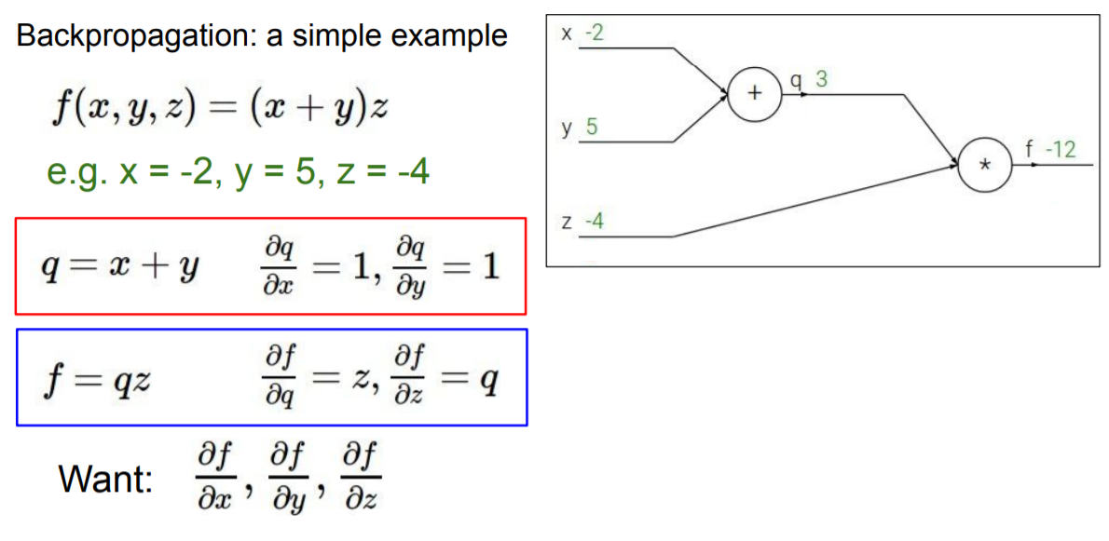

Slide 9
This is called- the forward pass

Slide 10
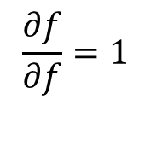
1
Step 0: initialization
$$\frac{∂f}{∂f}=1$$

Slide 11
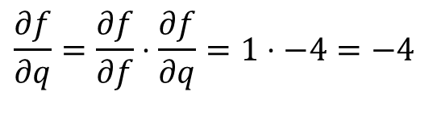
-4
junction
1
Iterative step: chain rule on locale junction.
$$\frac{∂f}{∂q}=\frac{∂f}{∂f}⋅\frac{∂f}{∂q}=1⋅−4=−4$$

Slide 12
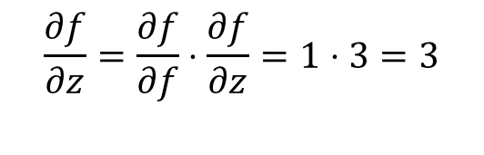
-4
junction
1
3
Iterative step: chain rule on locale junction.
$$\frac{∂f}{∂z}=\frac{∂f}{∂f}⋅\frac{∂f}{∂z}=1⋅3=3$$

Slide 13

-4
junction
1
3
Iterative step: chain rule on locale junction.
$$\frac{∂f}{∂z}=\frac{∂f}{∂f}⋅\frac{∂f}{∂z}=1⋅3=3$$

Slide 14
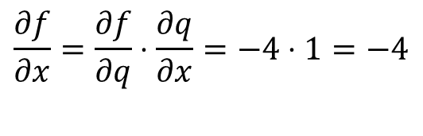
junction
-4
-4
1
3
Iterative step: chain rule on locale junction.
$$\frac{∂f}{∂x}=\frac{∂f}{∂q}⋅\frac{∂q}{∂x}=−4⋅1=−4$$

Slide 15
junction
-4
-4
1
3
Iterative step: chain rule on locale junction.
$$\frac{∂f}{∂x}=\frac{∂f}{∂q}⋅\frac{∂q}{∂x}=−4⋅1=−4$$

Slide 16
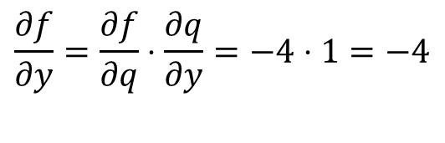
junction
-4
-4
-4
1
3
Iterative step: chain rule on locale junction.
$$\frac{∂f}{∂y}=\frac{∂f}{∂q}⋅\frac{∂q}{∂y}=−4⋅1=−4$$

Slide 17
junction
-4
-4
-4
1
3
Iterative step: chain rule on locale junction.
$$\frac{∂f}{∂y}=\frac{∂f}{∂q}⋅\frac{∂q}{∂y}=−4⋅1=−4$$

Slide 18
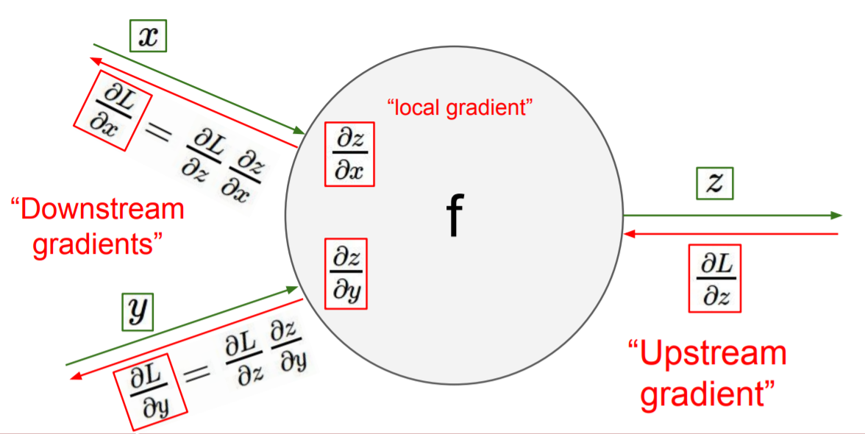
Backpropagation- conclusions
All that we need to know in each junction is:
The local gradient from the junction’s equation.
the chain rule result that was “back propagated” to the junction.

Slide 19
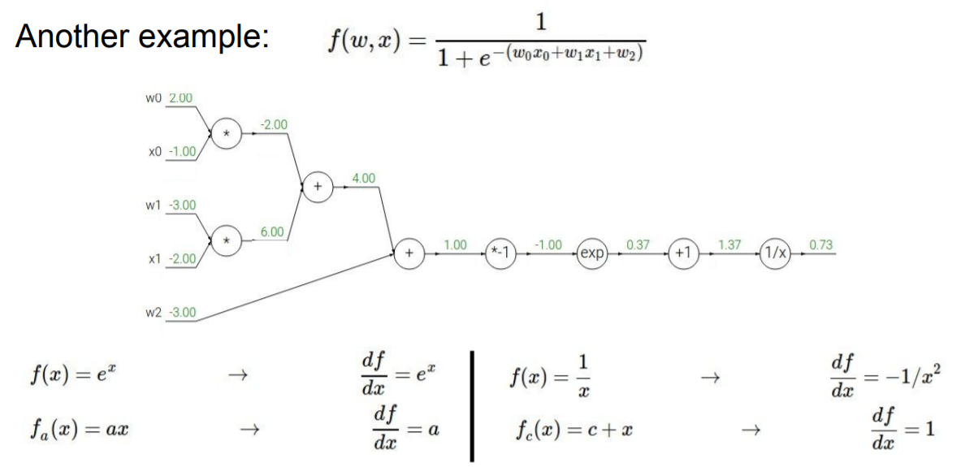
1

Slide 20
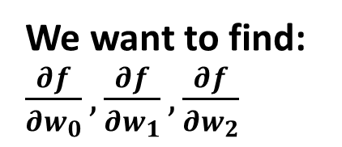
We want to find: $\frac{∂f}{∂w_{0}},\frac{∂f}{∂w_{1}},\frac{∂f}{∂w_{2}}$
1

Slide 21
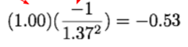
We want to find: $\frac{∂f}{∂w_{0}},\frac{∂f}{∂w_{1}},\frac{∂f}{∂w_{2}}$
-0.53
1

Slide 22
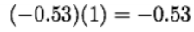
We want to find: $\frac{∂f}{∂w_{0}},\frac{∂f}{∂w_{1}},\frac{∂f}{∂w_{2}}$
-0.53
-0.53
1

Slide 23
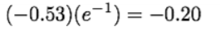
We want to find: $\frac{∂f}{∂w_{0}},\frac{∂f}{∂w_{1}},\frac{∂f}{∂w_{2}}$
-0.2
-0.53
-0.53
1

Slide 24
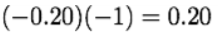
We want to find: $\frac{∂f}{∂w_{0}},\frac{∂f}{∂w_{1}},\frac{∂f}{∂w_{2}}$
0.2
-0.2
-0.53
-0.53
1

Slide 25
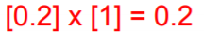
We want to find: $\frac{∂f}{∂w_{0}},\frac{∂f}{∂w_{1}},\frac{∂f}{∂w_{2}}$
0.2
0.2
-0.2
-0.53
-0.53
1

Slide 26
We want to find: $\frac{∂f}{∂w_{0}},\frac{∂f}{∂w_{1}},\frac{∂f}{∂w_{2}}$
0.2
0.2
-0.2
-0.53
-0.53
1
0.2

Slide 27
We want to find: $\frac{∂f}{∂w_{0}},\frac{∂f}{∂w_{1}},\frac{∂f}{∂w_{2}}$
0.2
0.2
0.2
-0.2
-0.53
-0.53
1
0.2

Slide 28
We want to find: $\frac{∂f}{∂w_{0}},\frac{∂f}{∂w_{1}},\frac{∂f}{∂w_{2}}$
0.2
0.2
0.2
0.2
-0.2
-0.53
-0.53
1
0.2

Slide 29
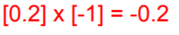
We want to find: $\frac{∂f}{∂w_{0}},\frac{∂f}{∂w_{1}},\frac{∂f}{∂w_{2}}$
-0.2
0.2
0.2
0.2
0.2
-0.2
-0.53
-0.53
1
0.2

Slide 30
We want to find: $\frac{∂f}{∂w_{0}},\frac{∂f}{∂w_{1}},\frac{∂f}{∂w_{2}}$
-0.2
0.2
[0.2]*[-2]=-0.4
0.2
-0.4
0.2
0.2
-0.2
-0.53
-0.53
1
0.2

Slide 31
contents
Chain rule
ConvNets
Convolution layer
Pooling layer
Overfitting
Architectures
Alexnet (dropout)
VGG
ResNet (batch norm)

Slide 32
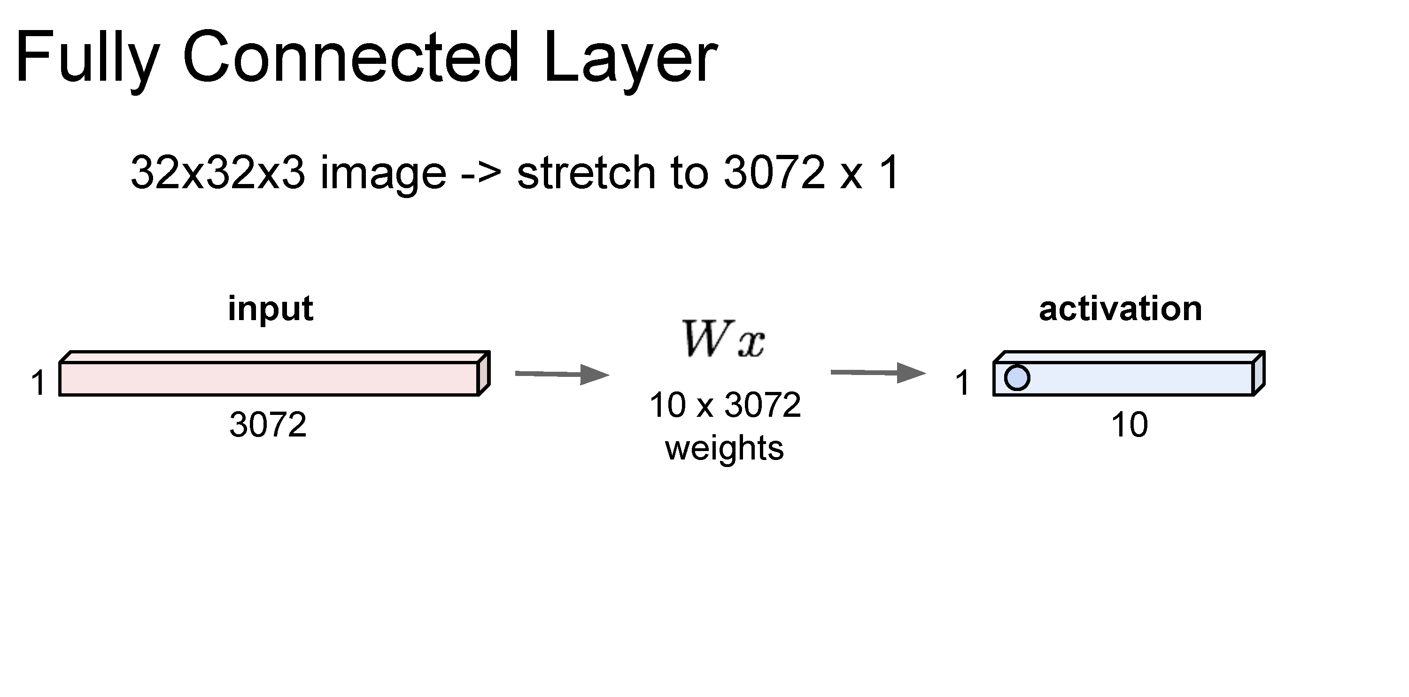

Slide 33
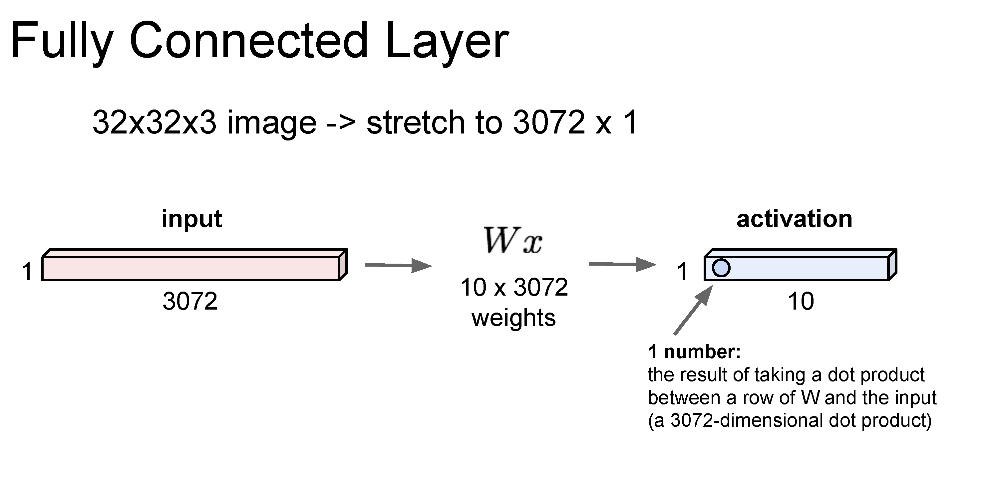

Slide 34
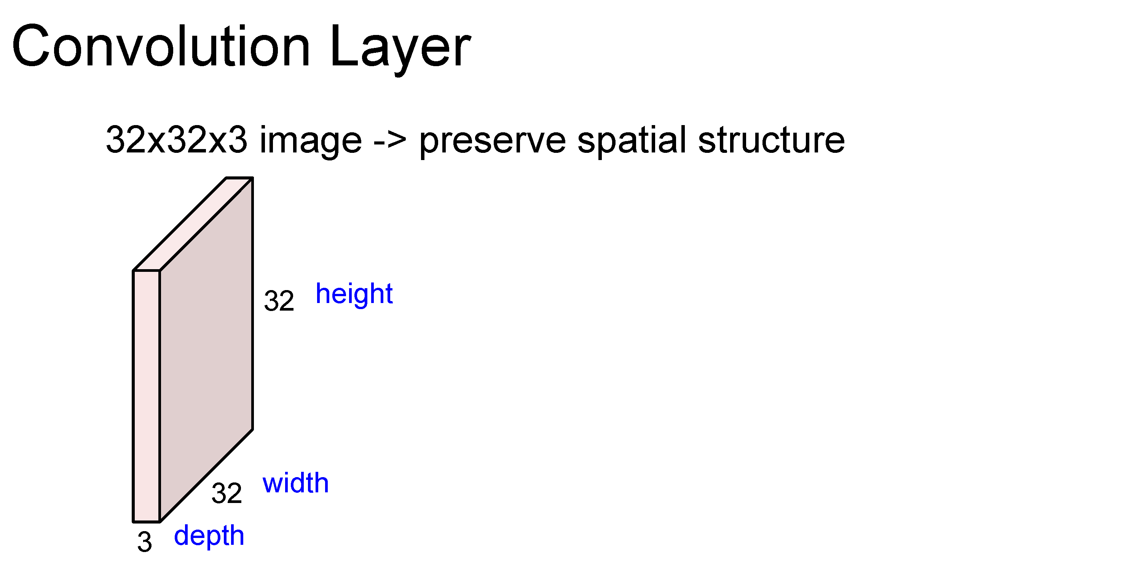

Slide 35
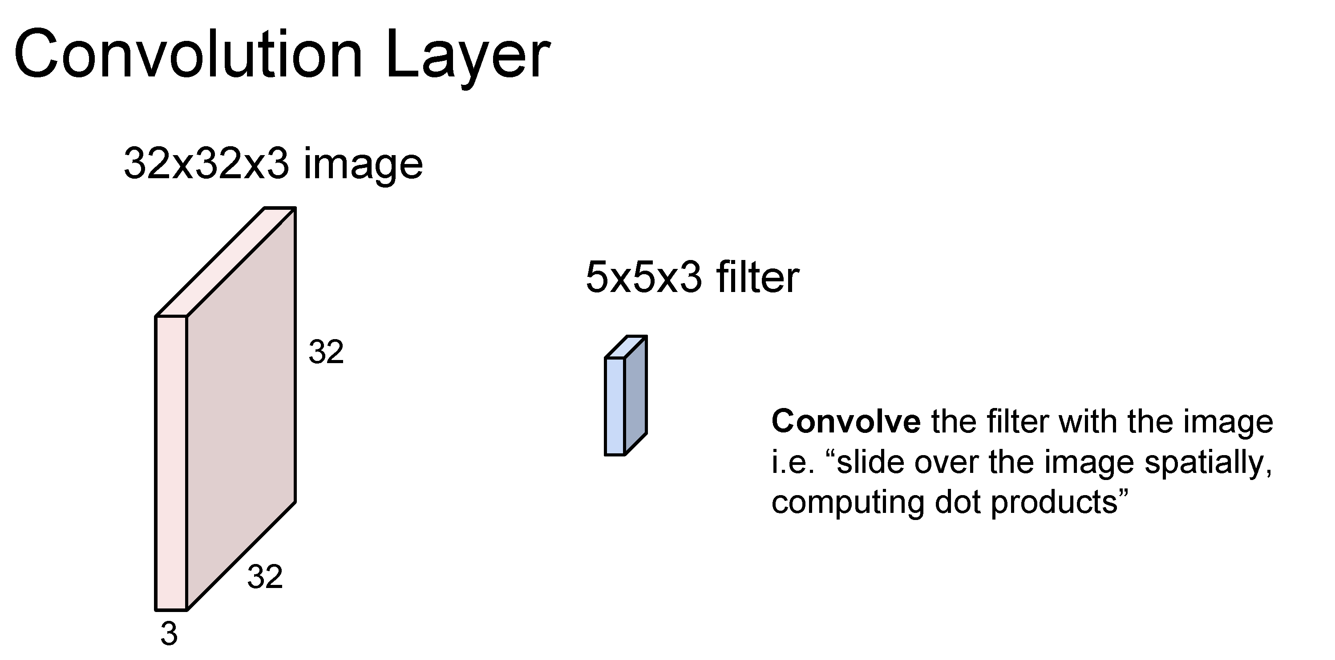

Slide 36
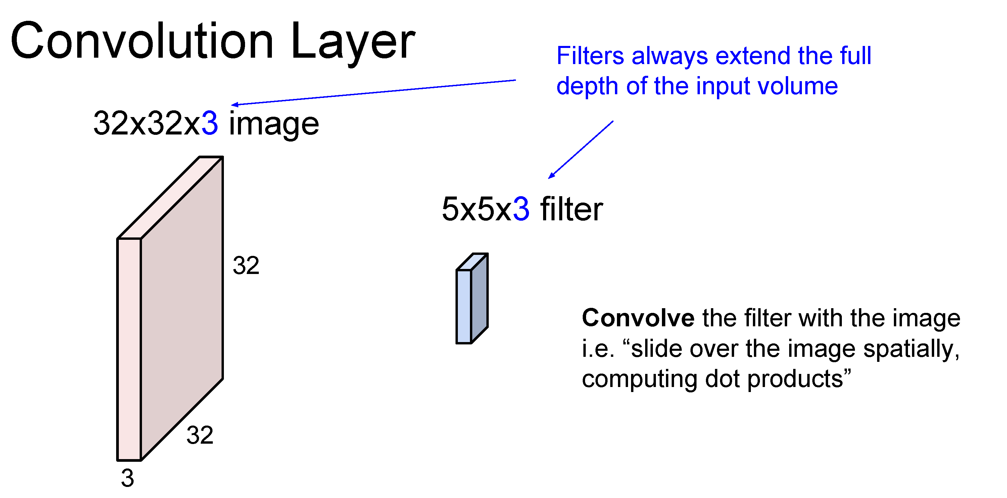

Slide 37
Number of weights: 5 x 5 x 3 + 1 = 76
(vs. 3072 for a fully-connected layer)
(+1 for bias)

Slide 38
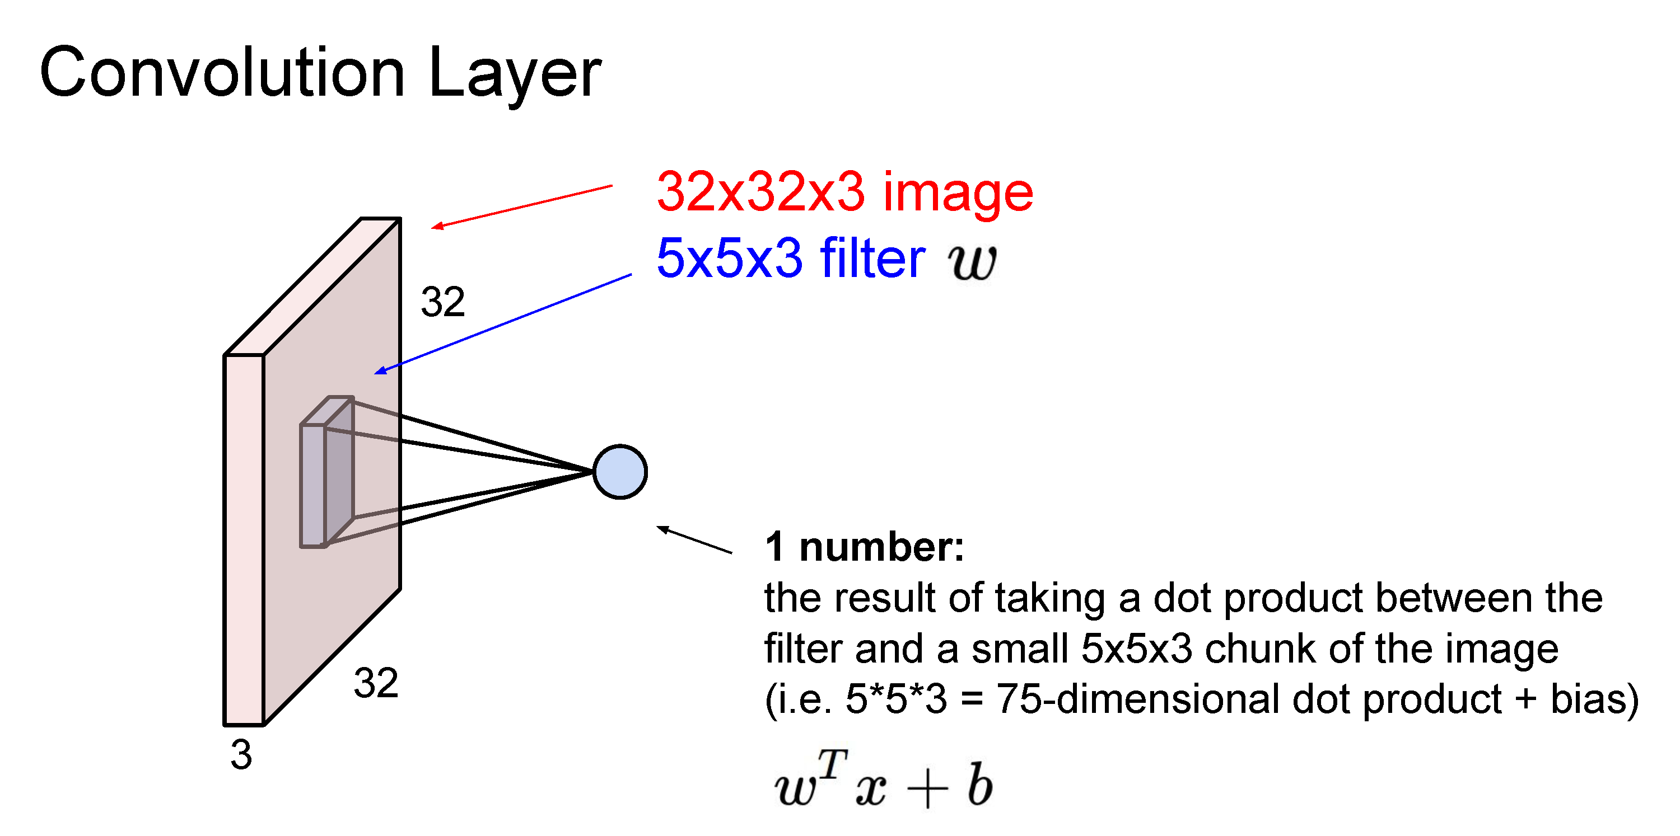

Slide 39
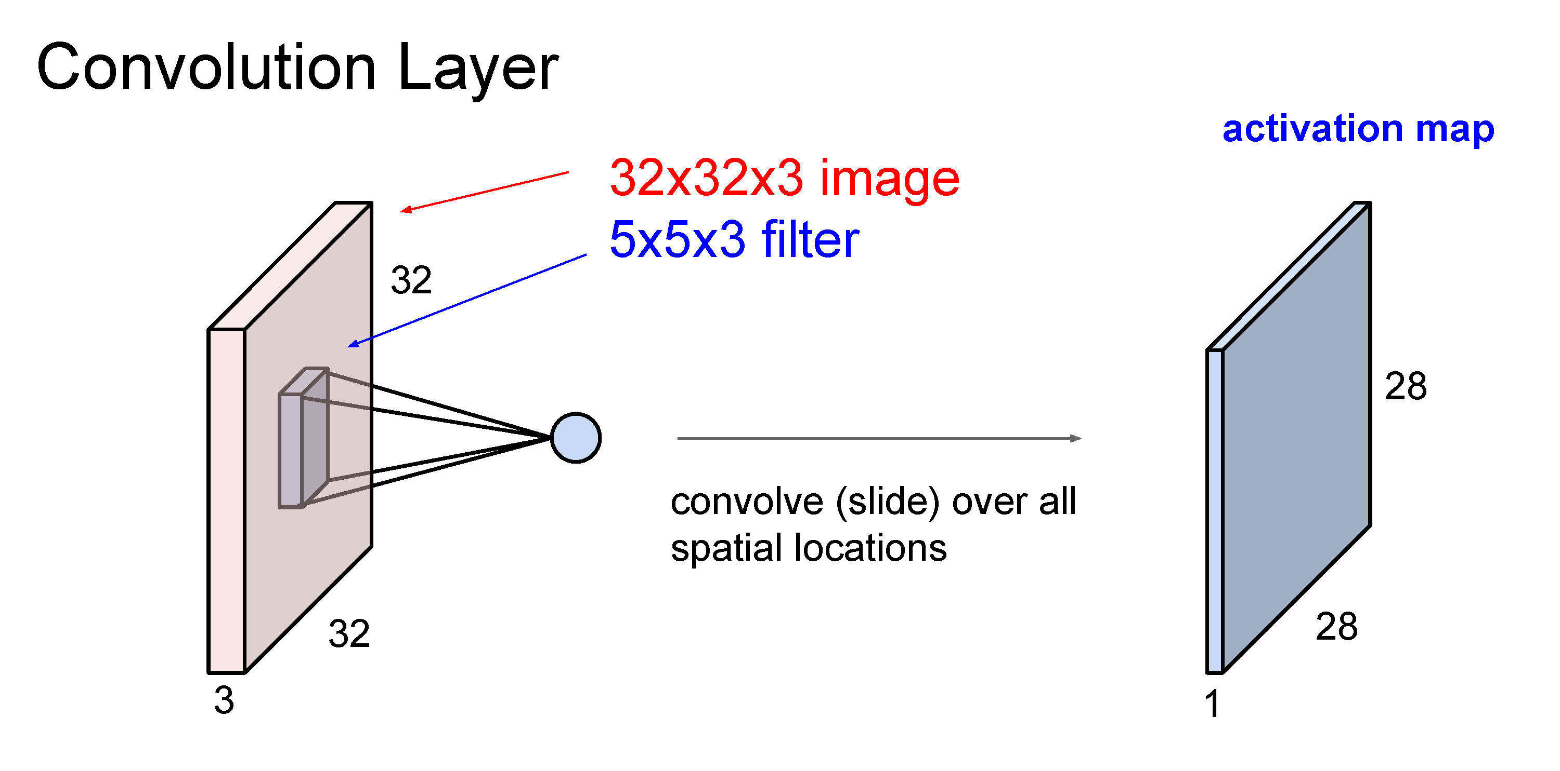

Slide 40
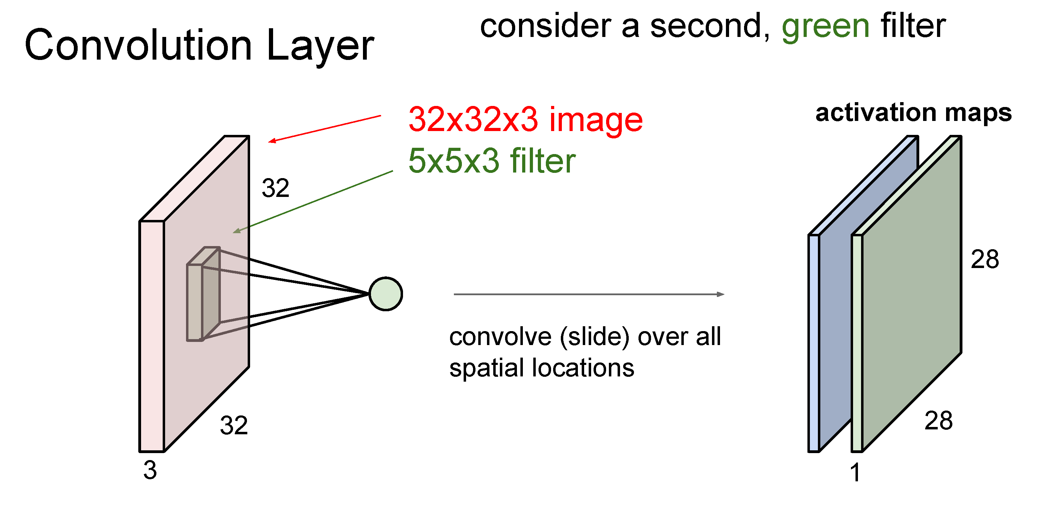

Slide 41
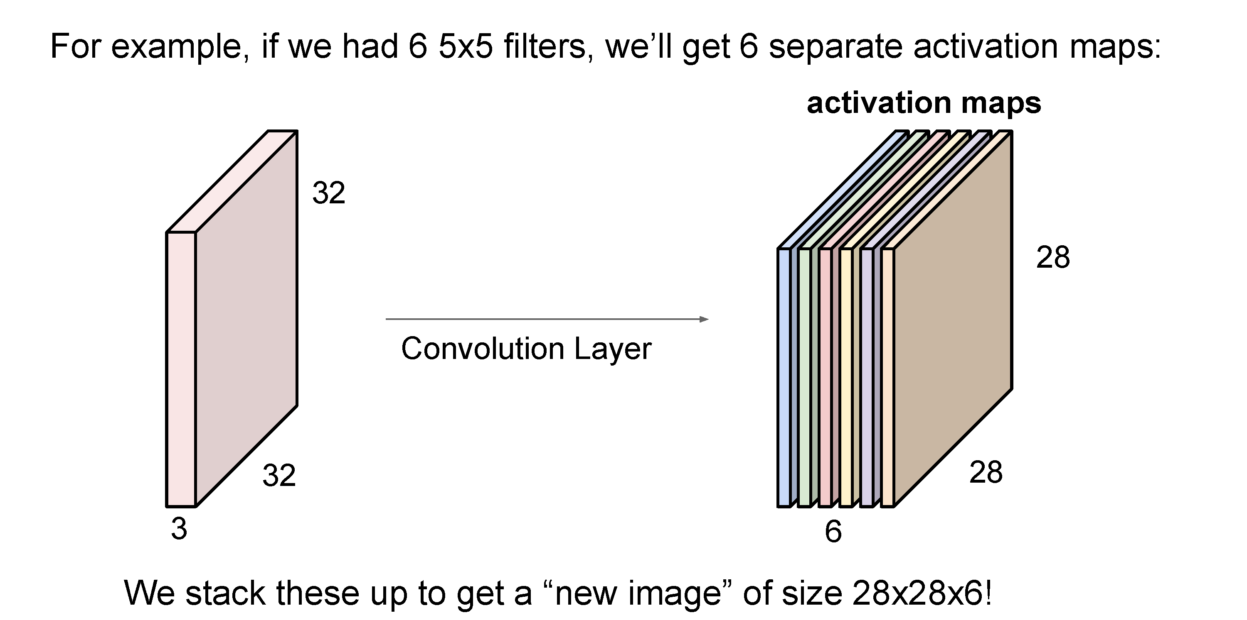
(total number of parameters: 6 x (75 + 1) = 456)

Slide 42
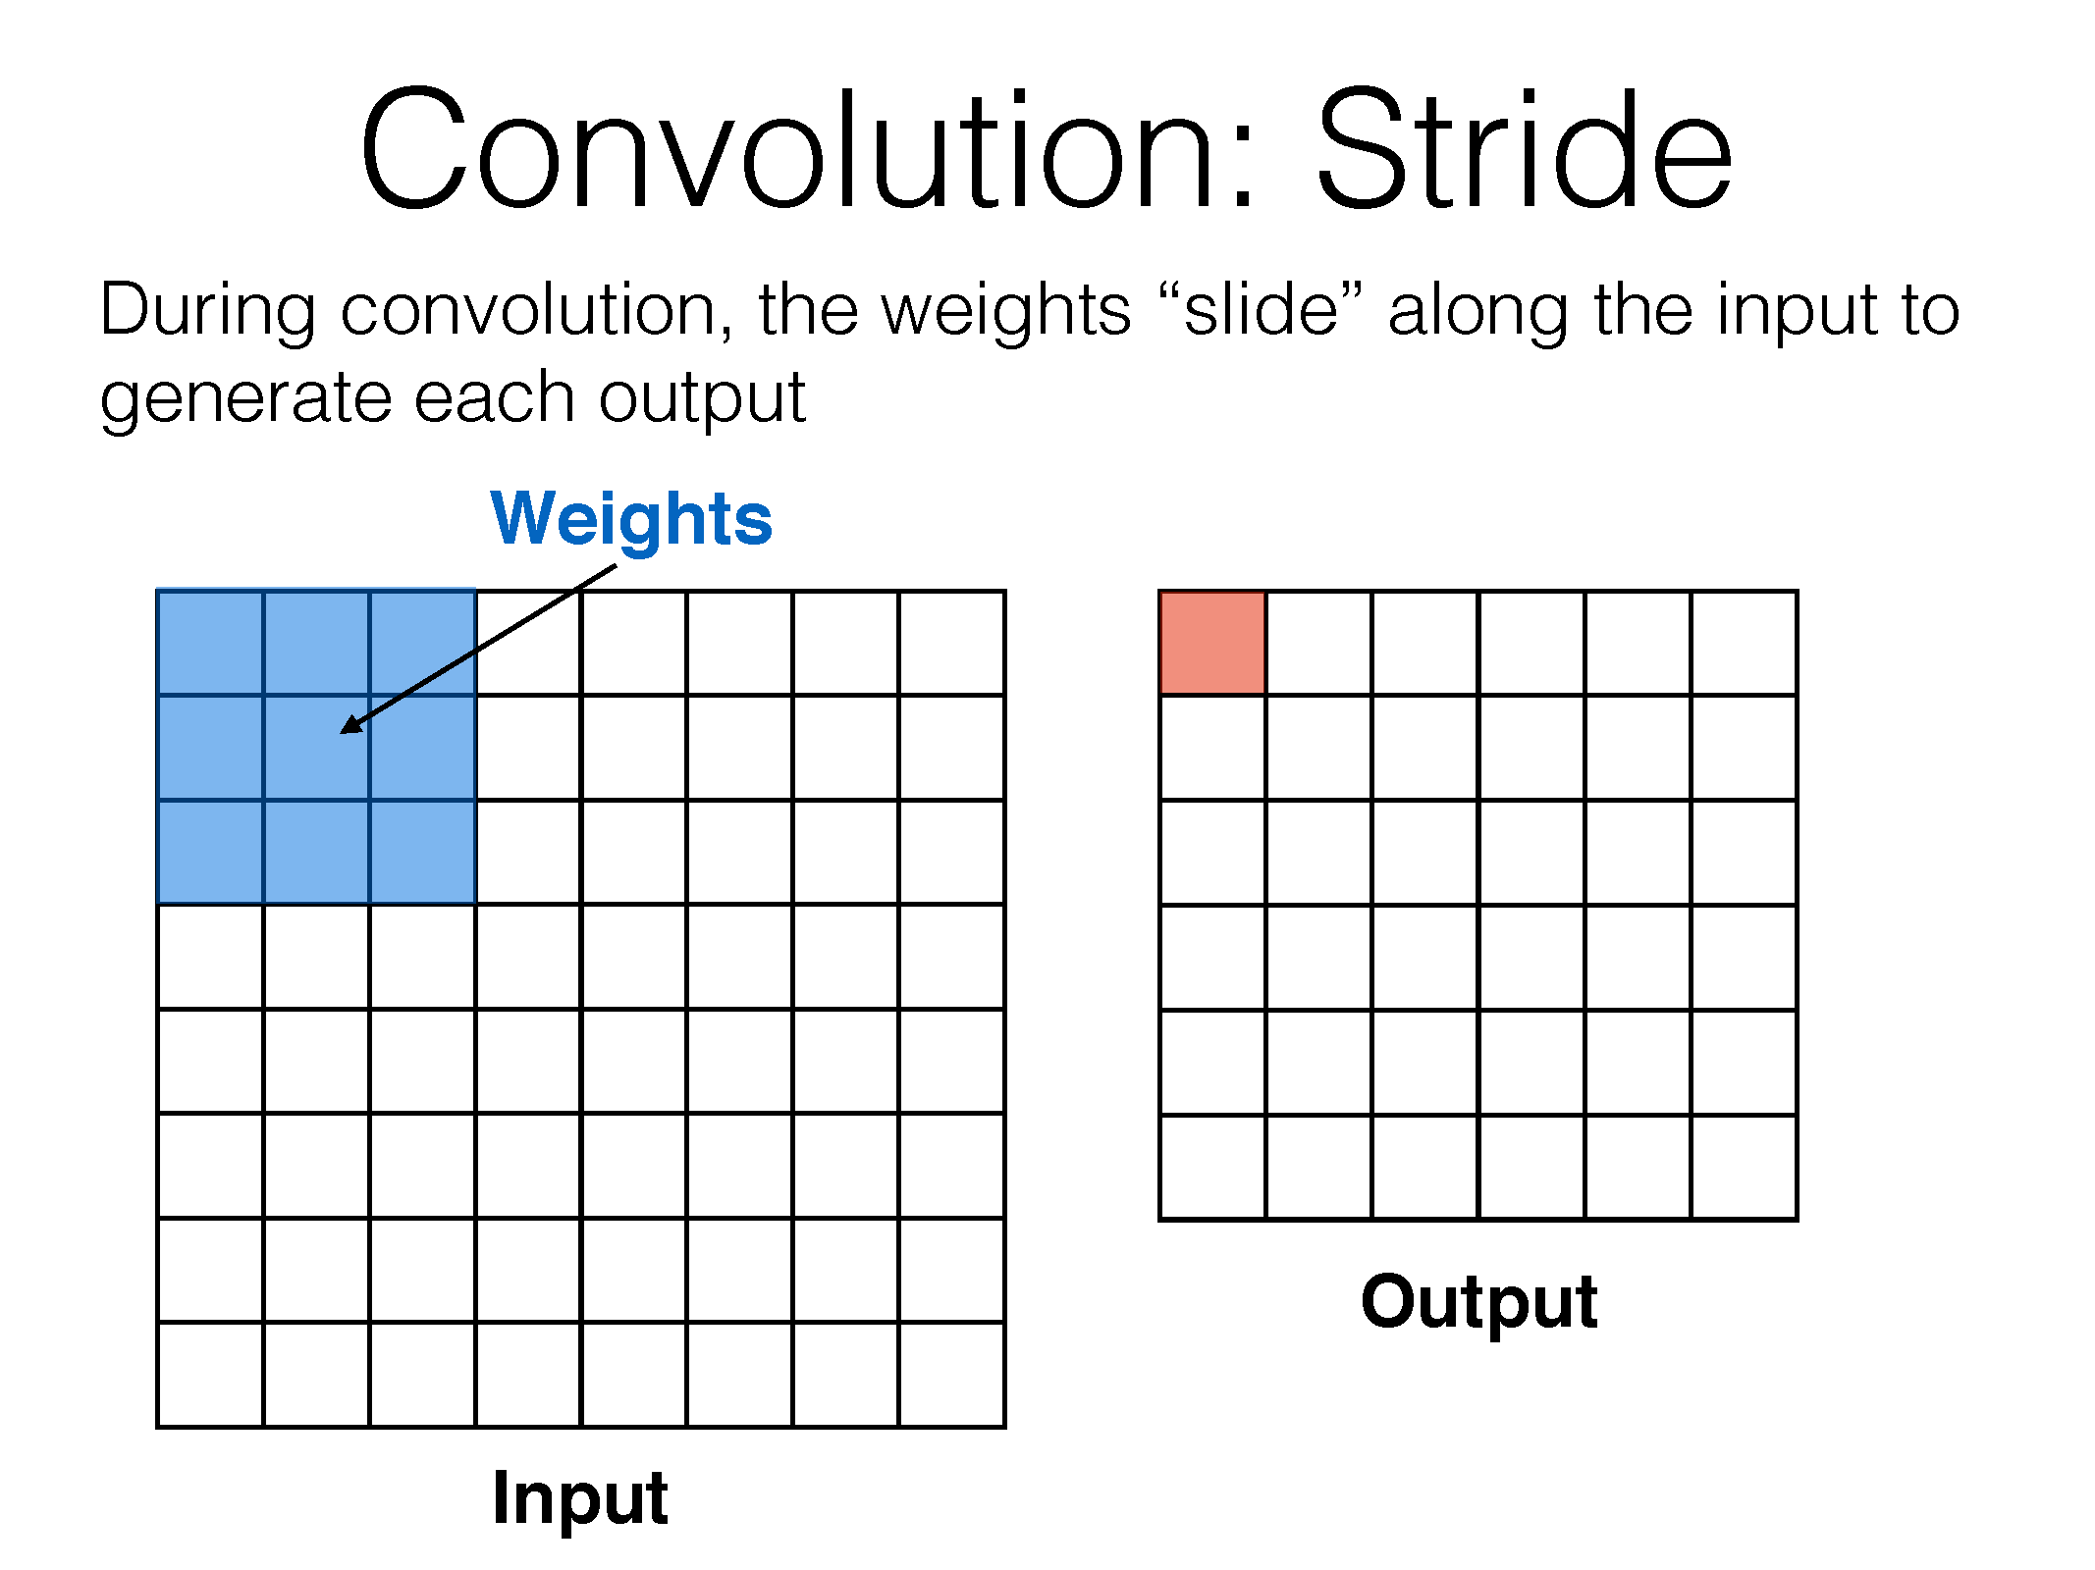

Slide 43
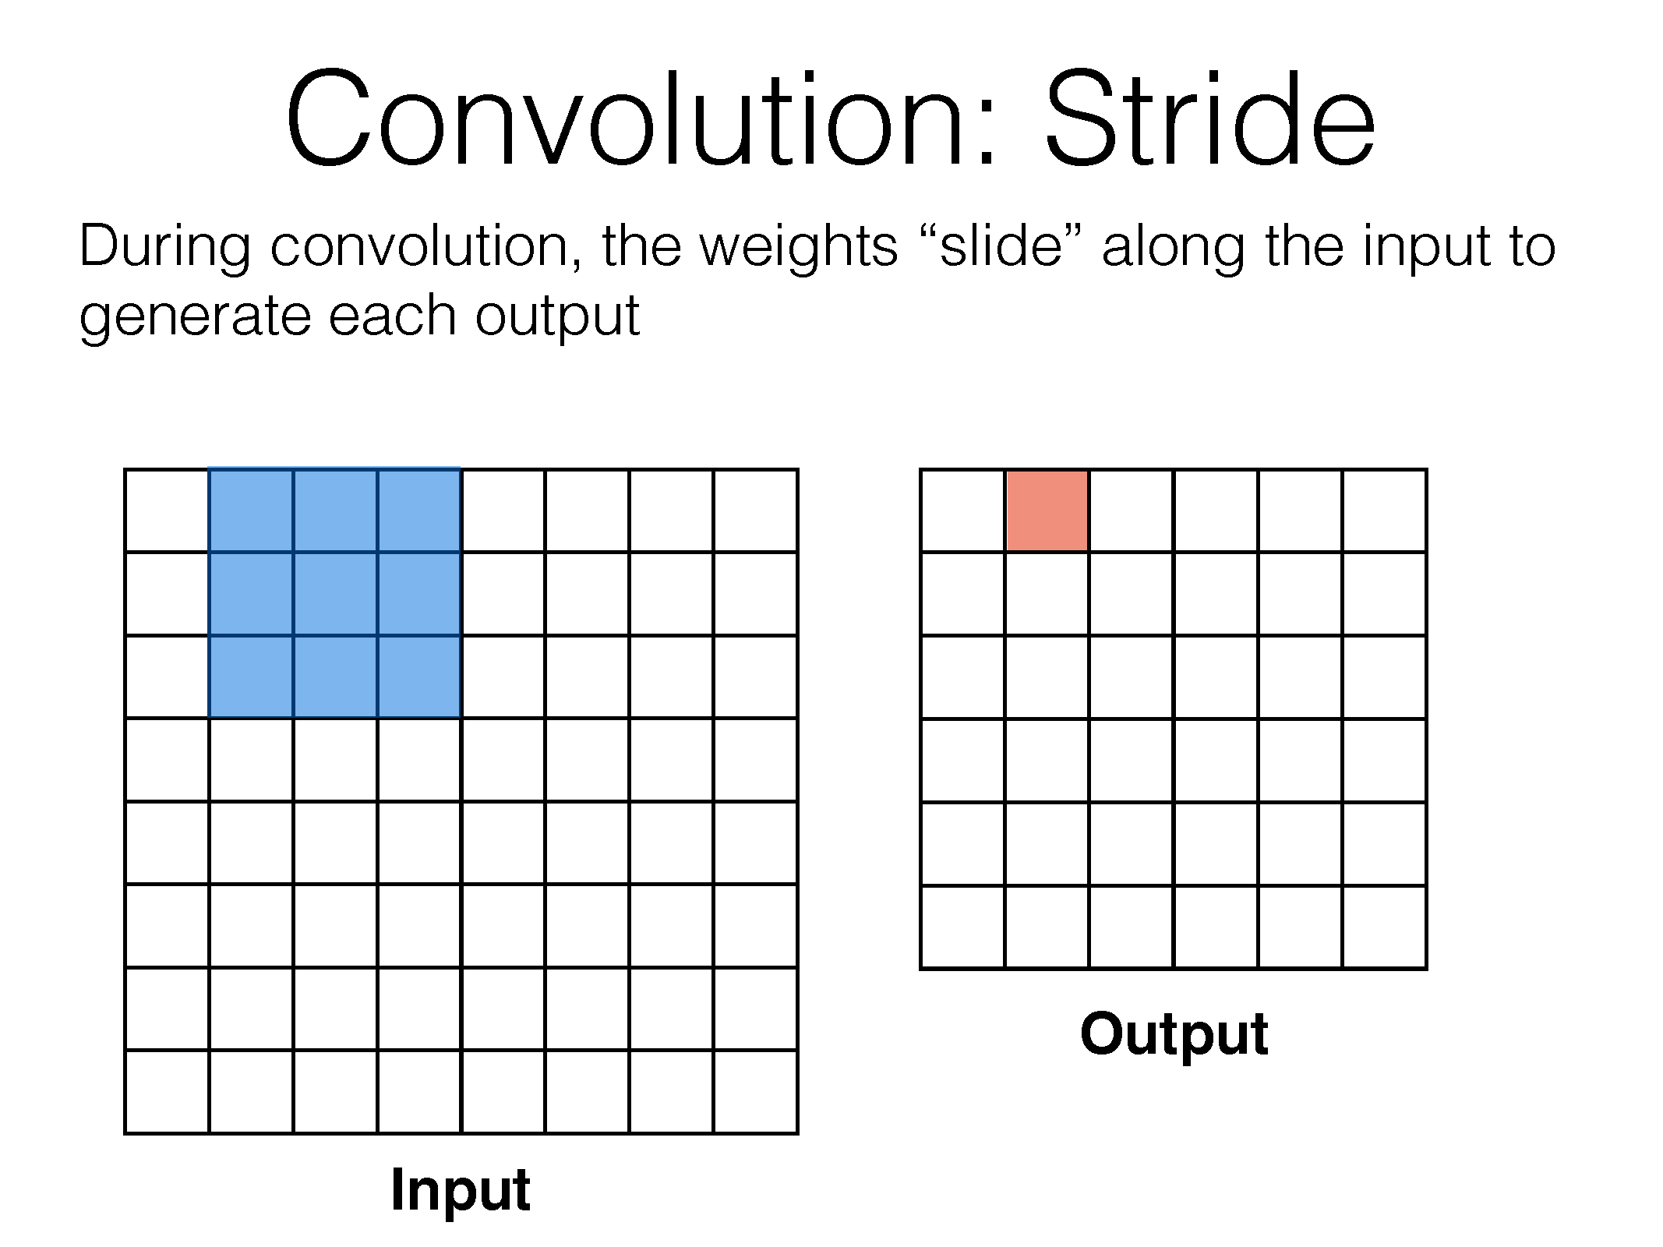

Slide 44
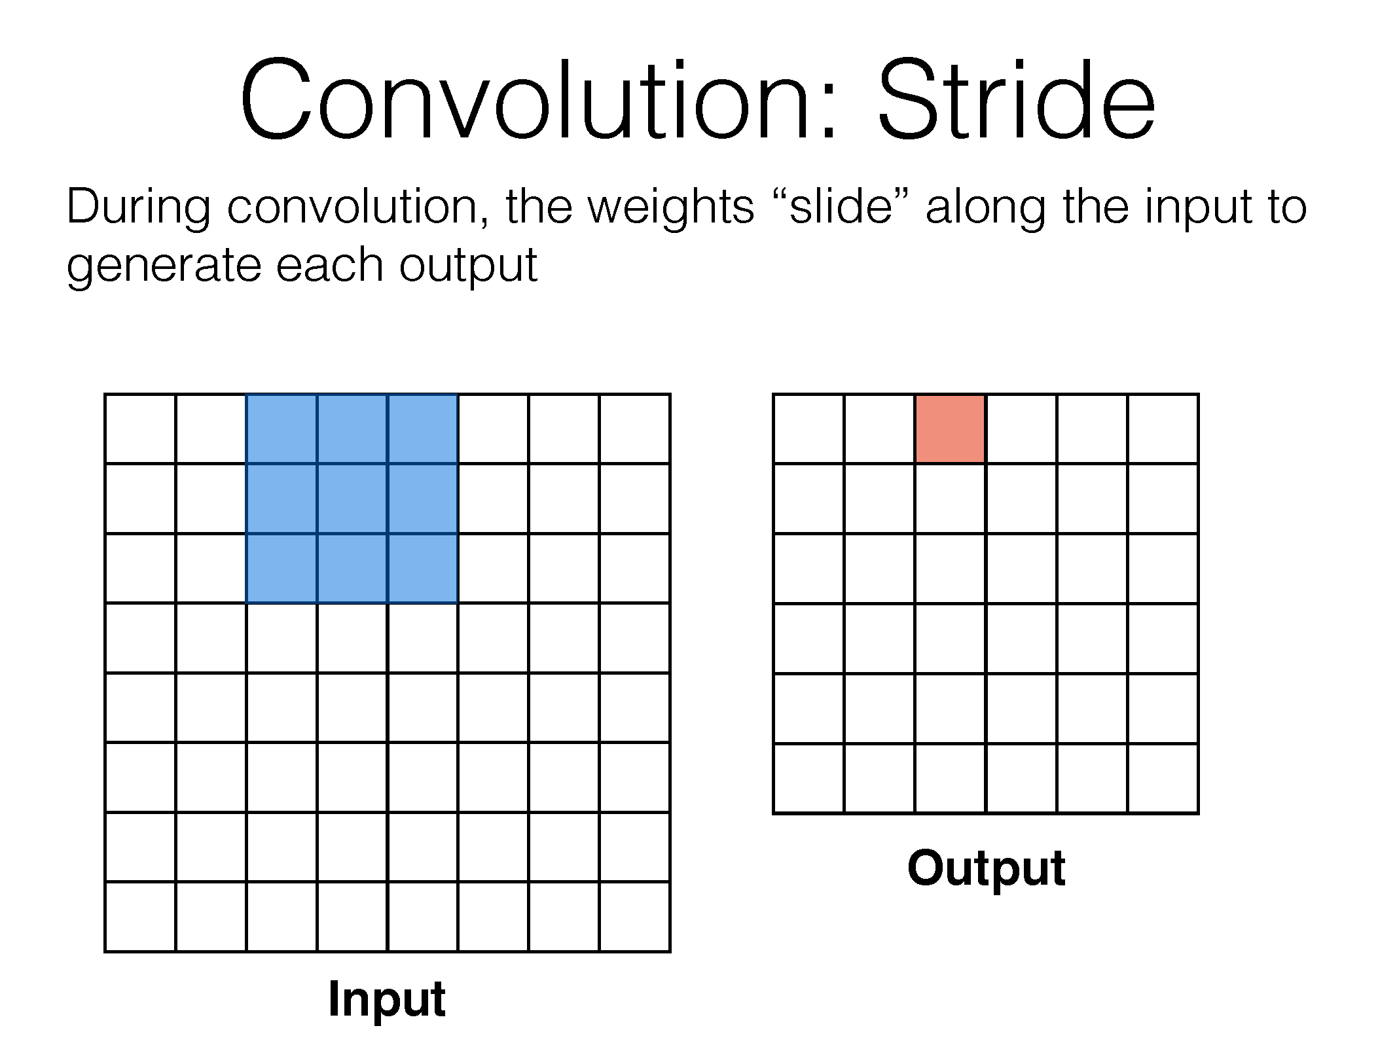

Slide 45
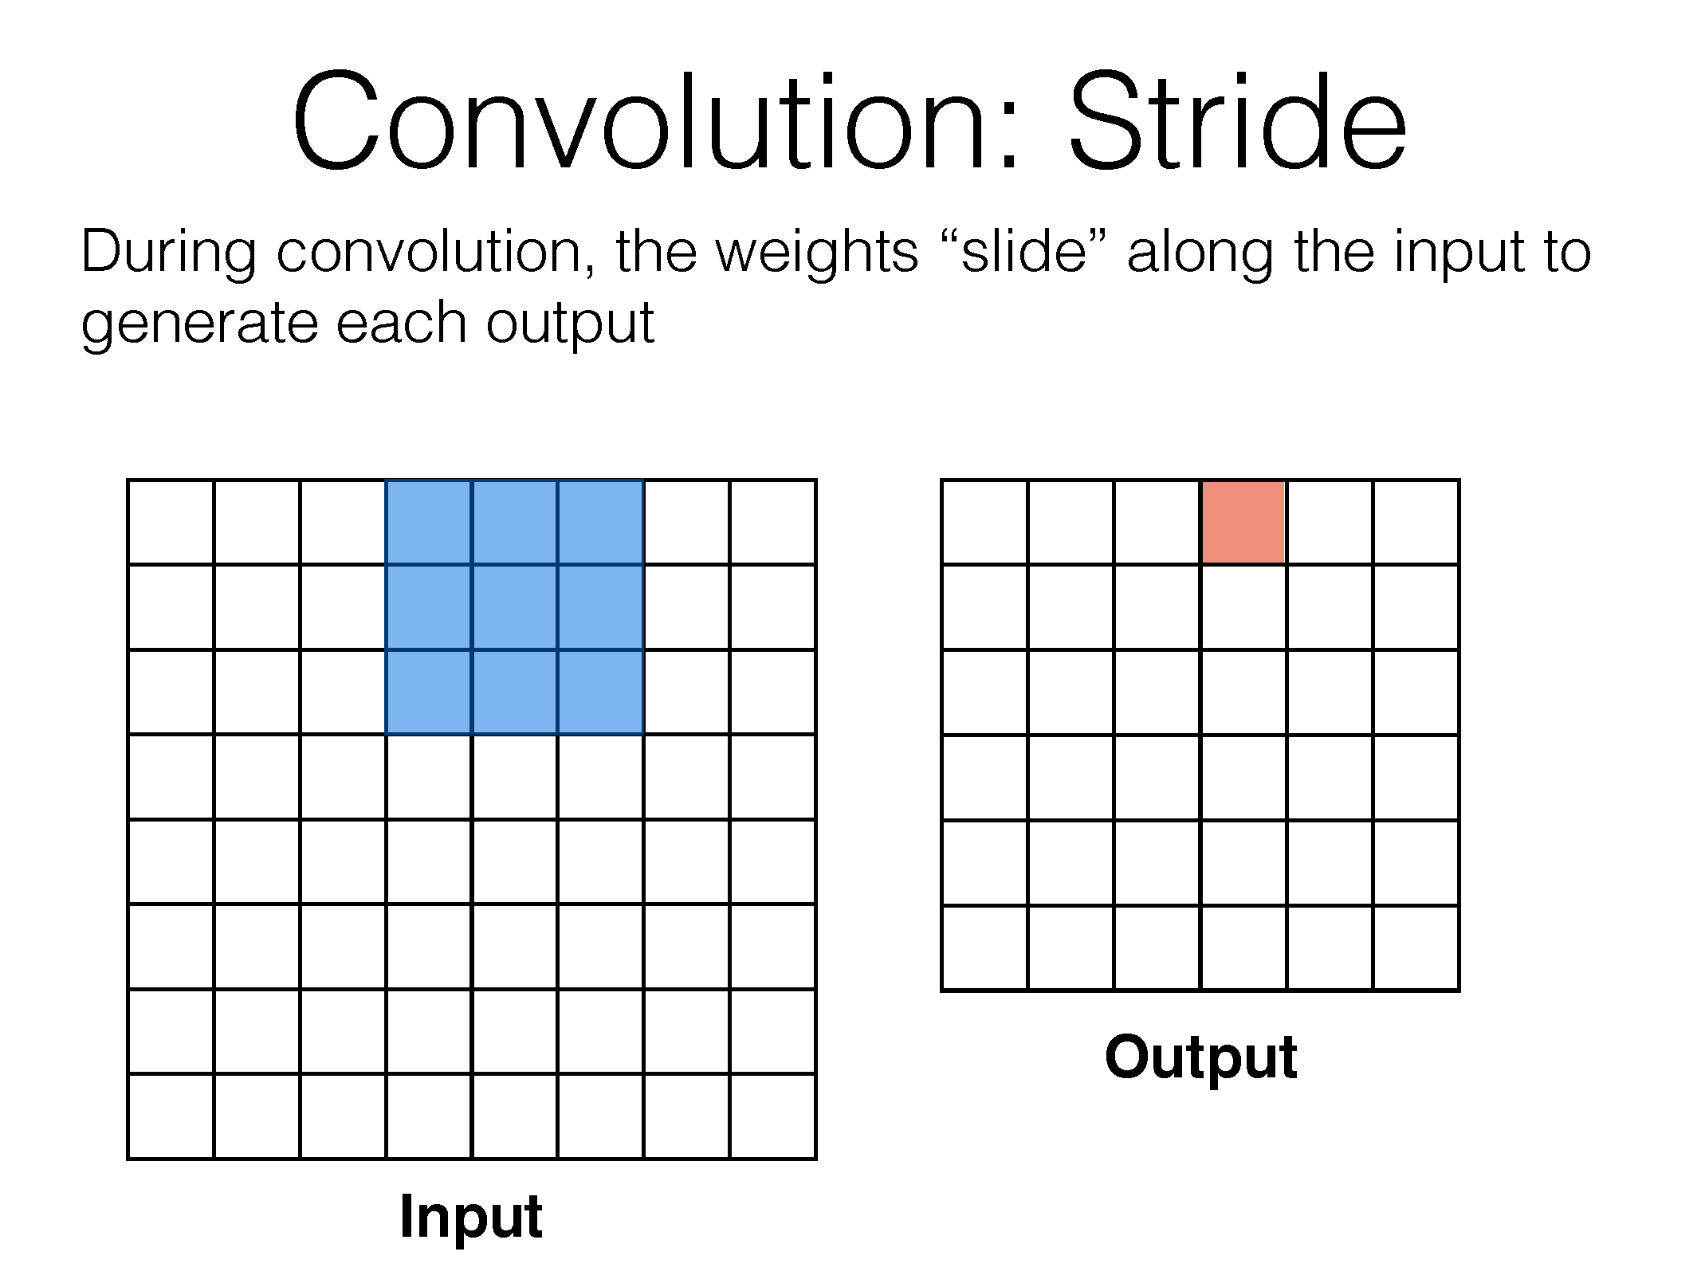

Slide 46
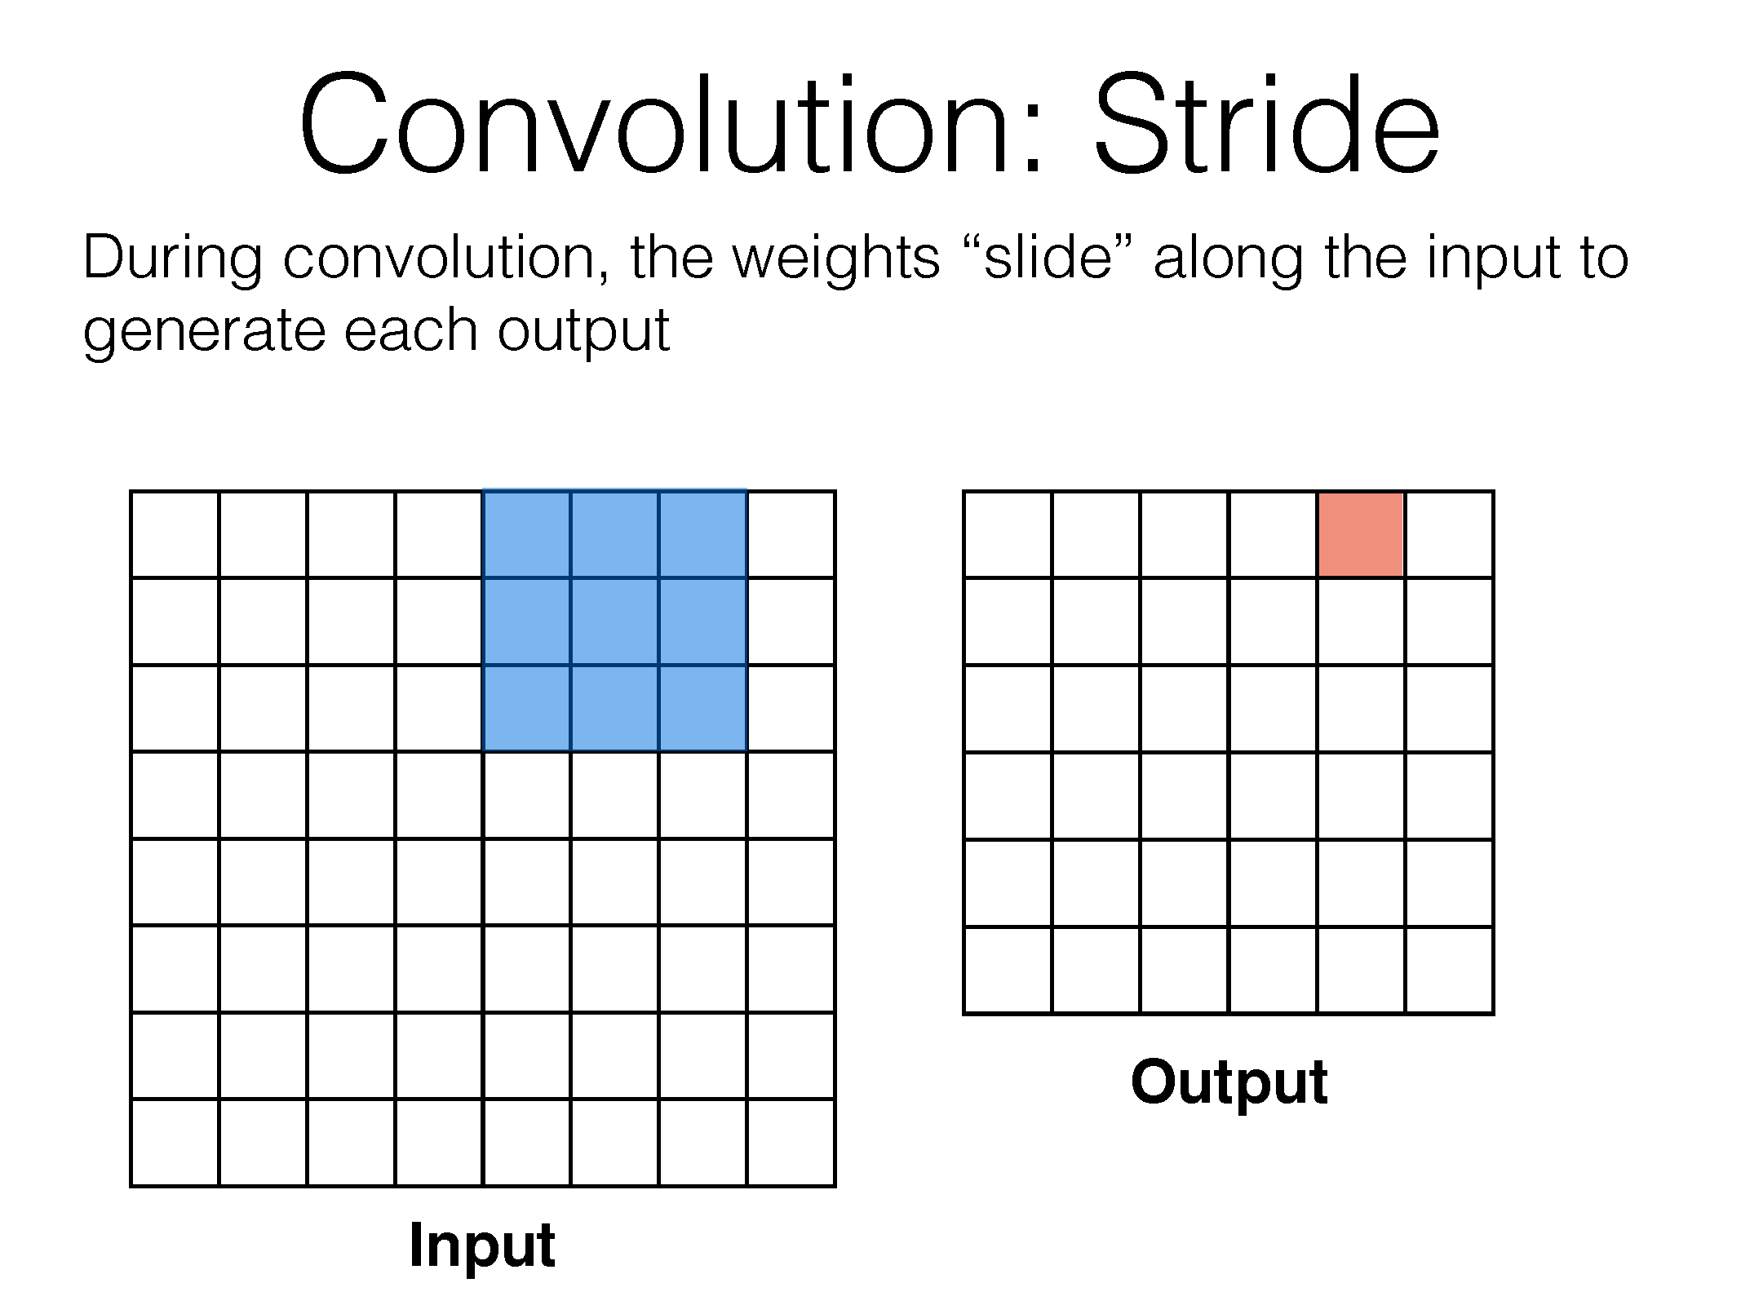

Slide 47
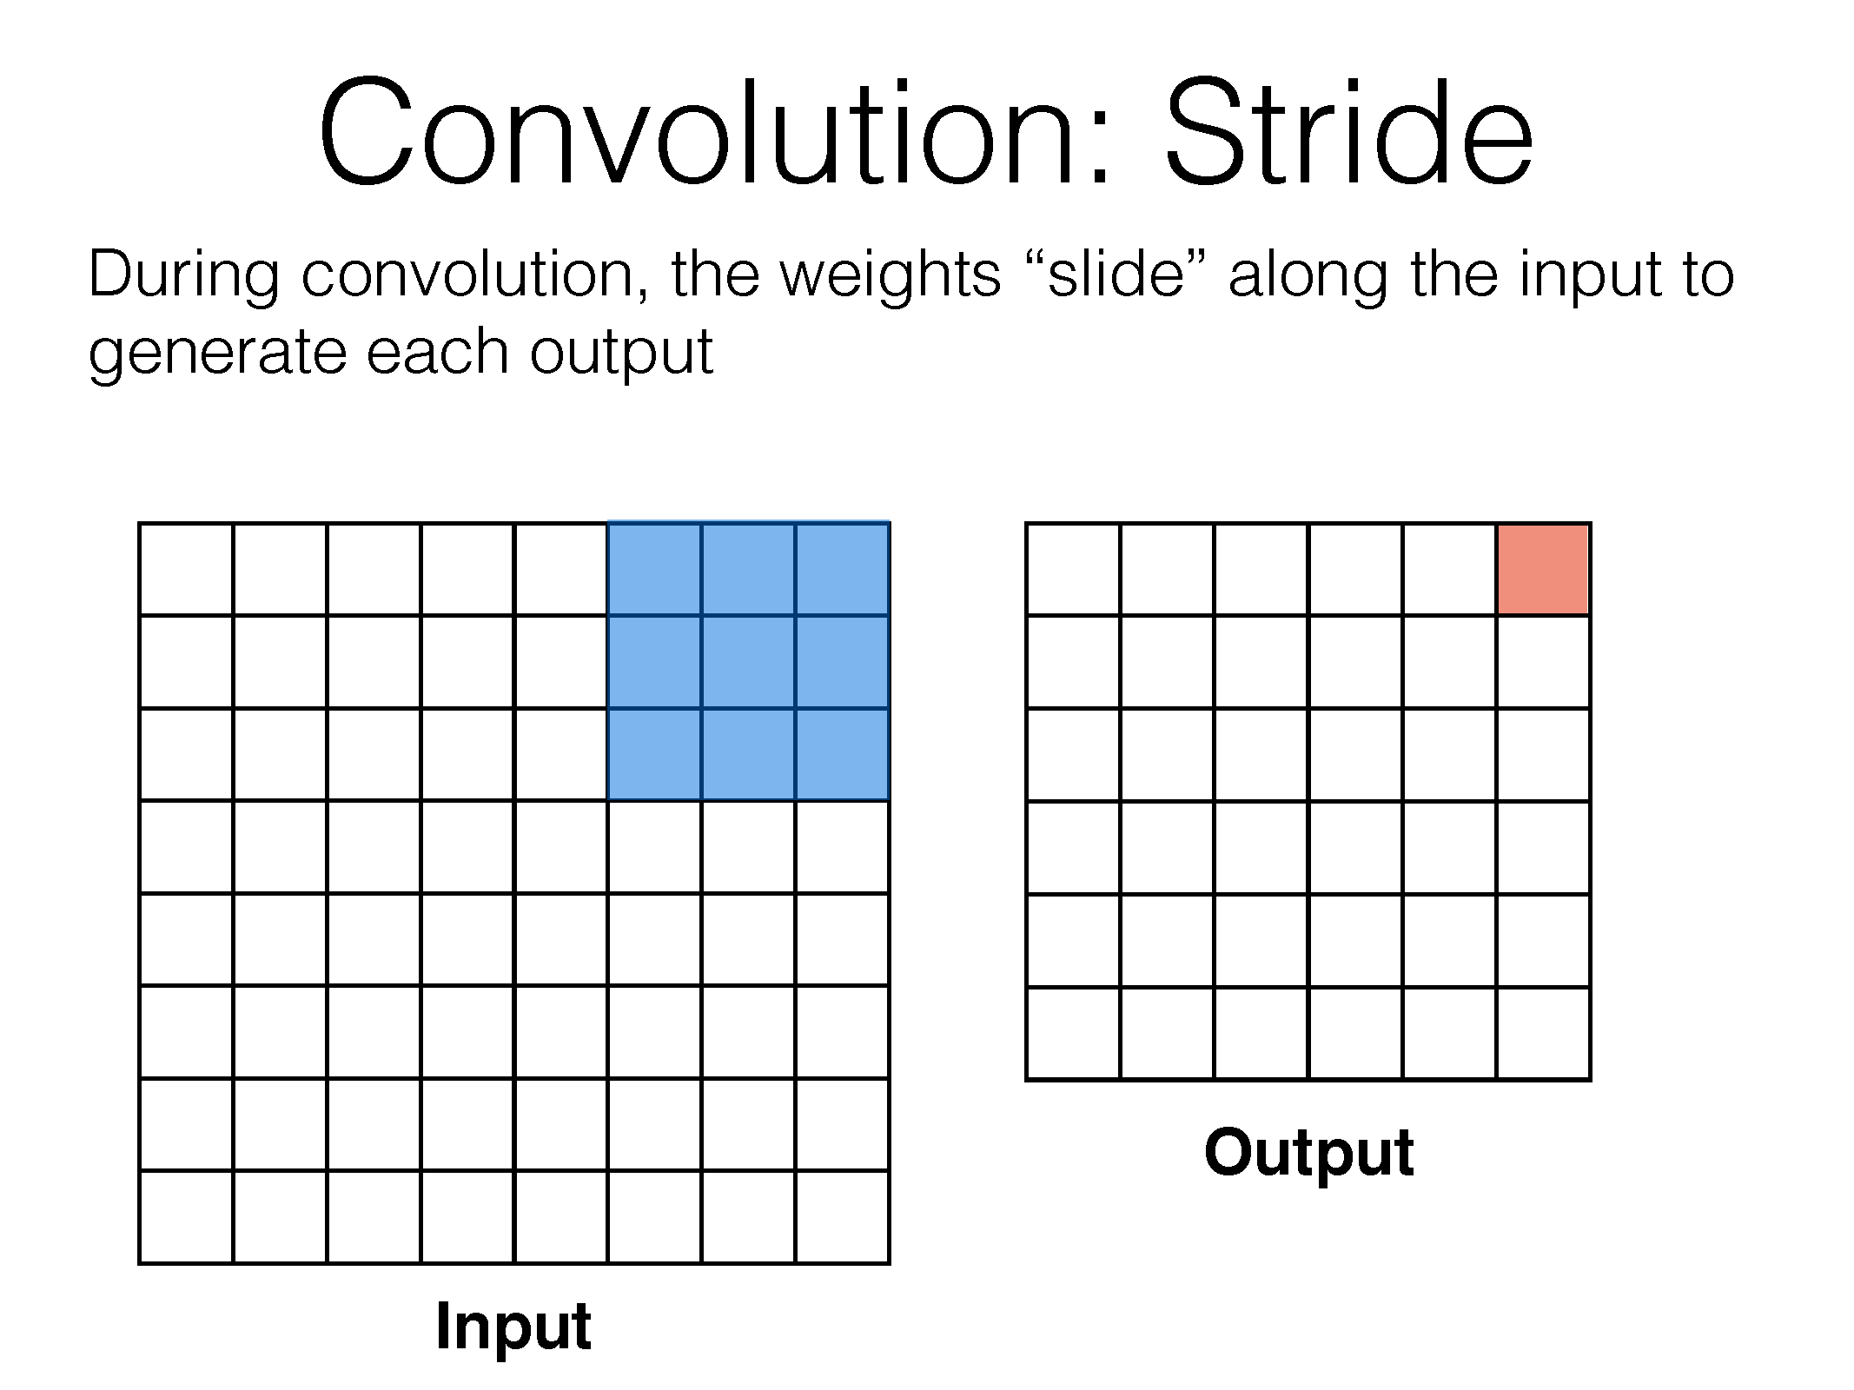

Slide 48
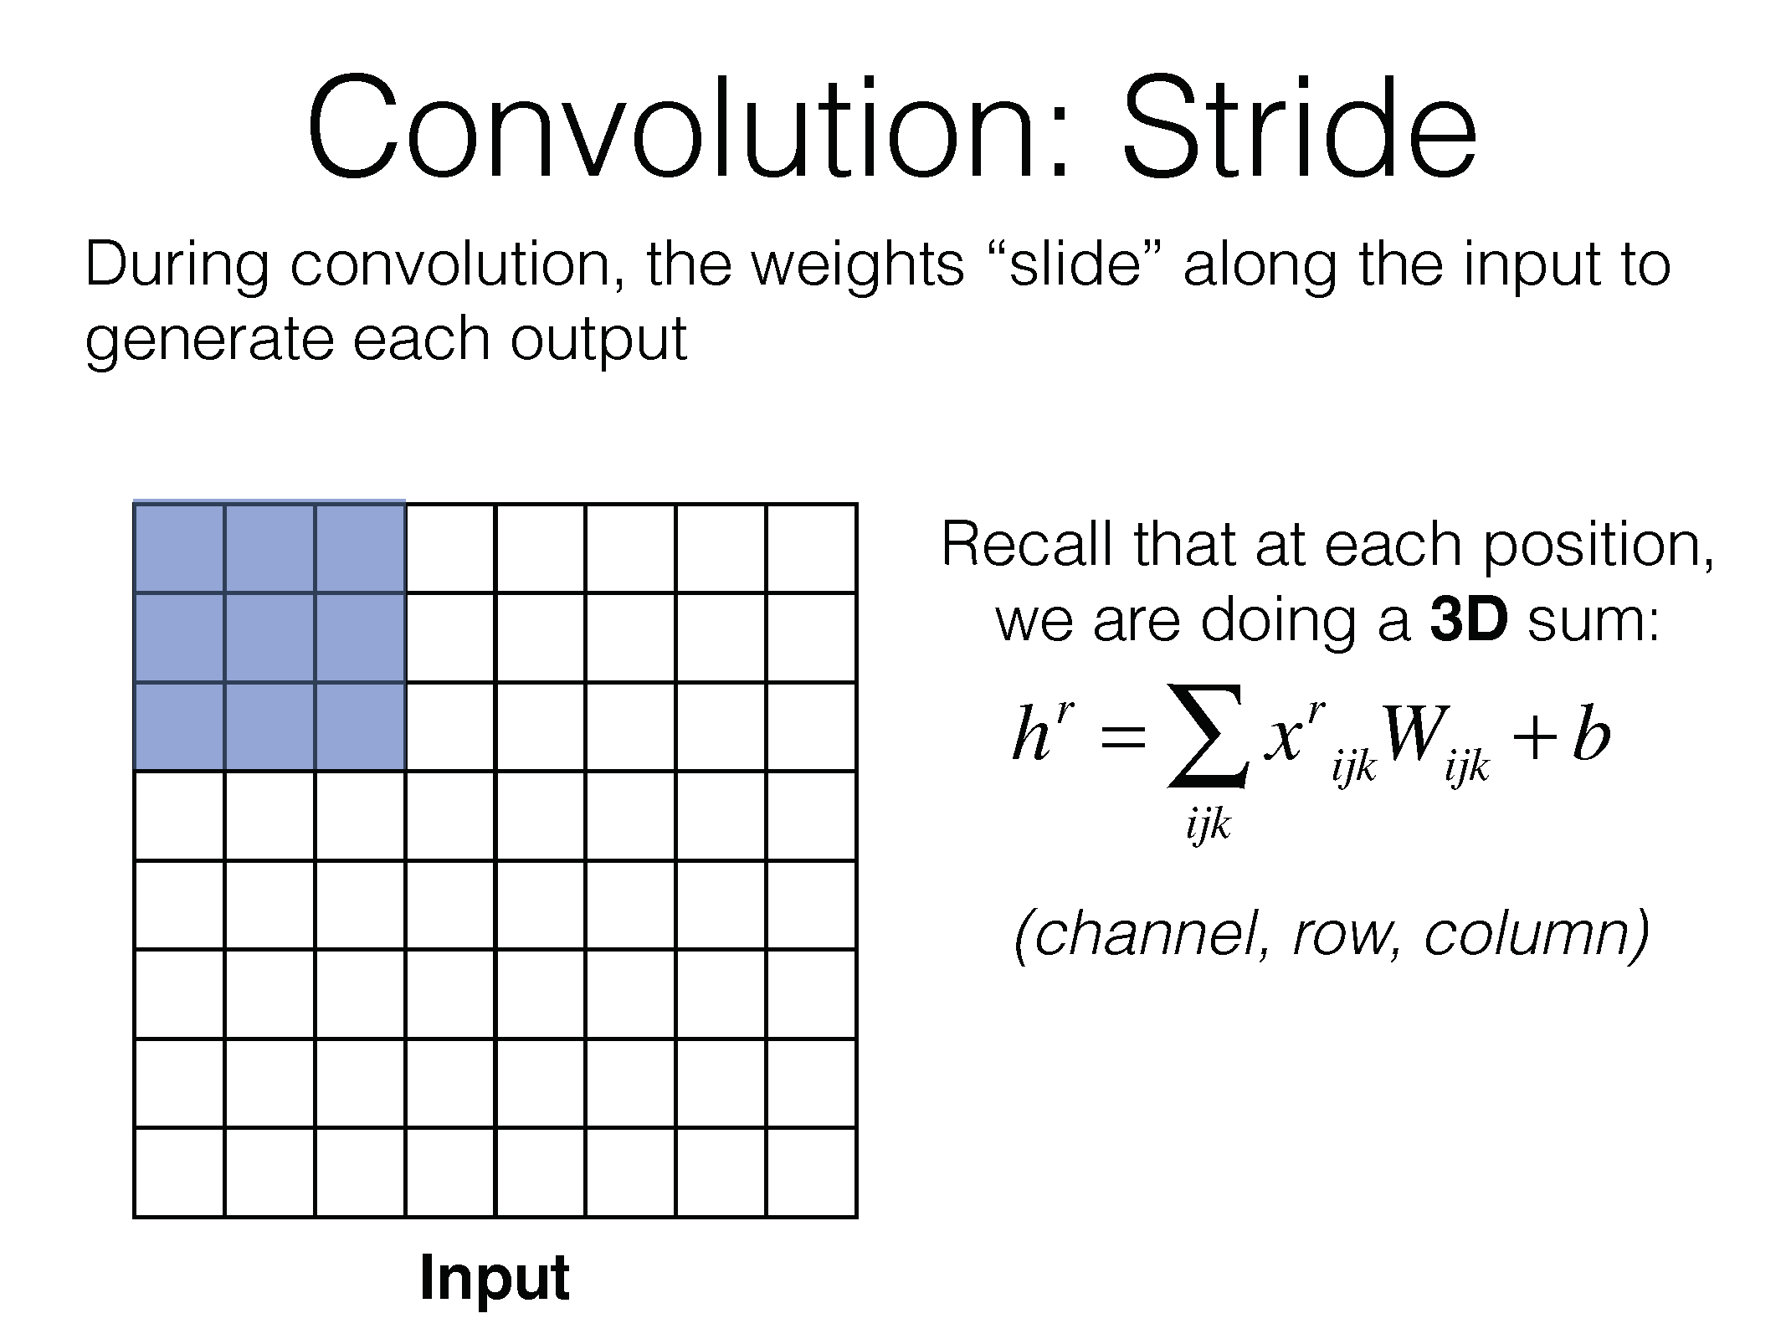

Slide 49
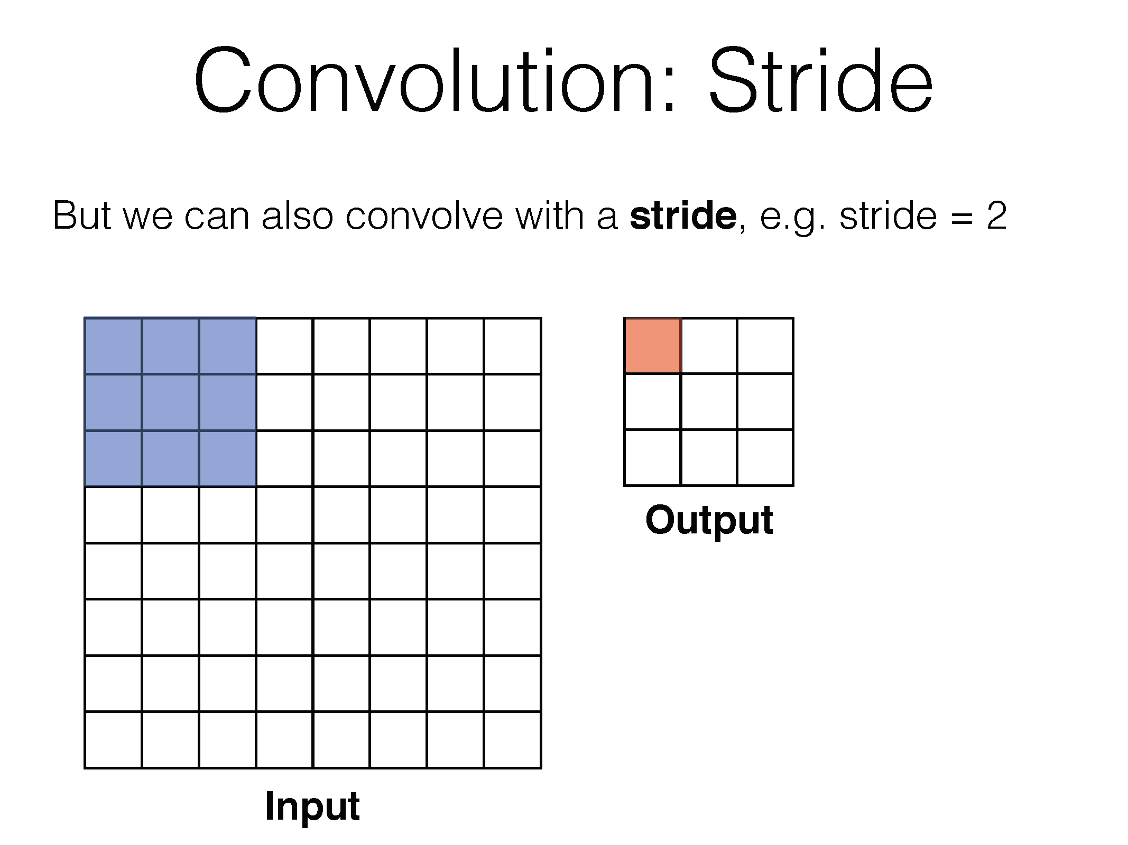

Slide 50
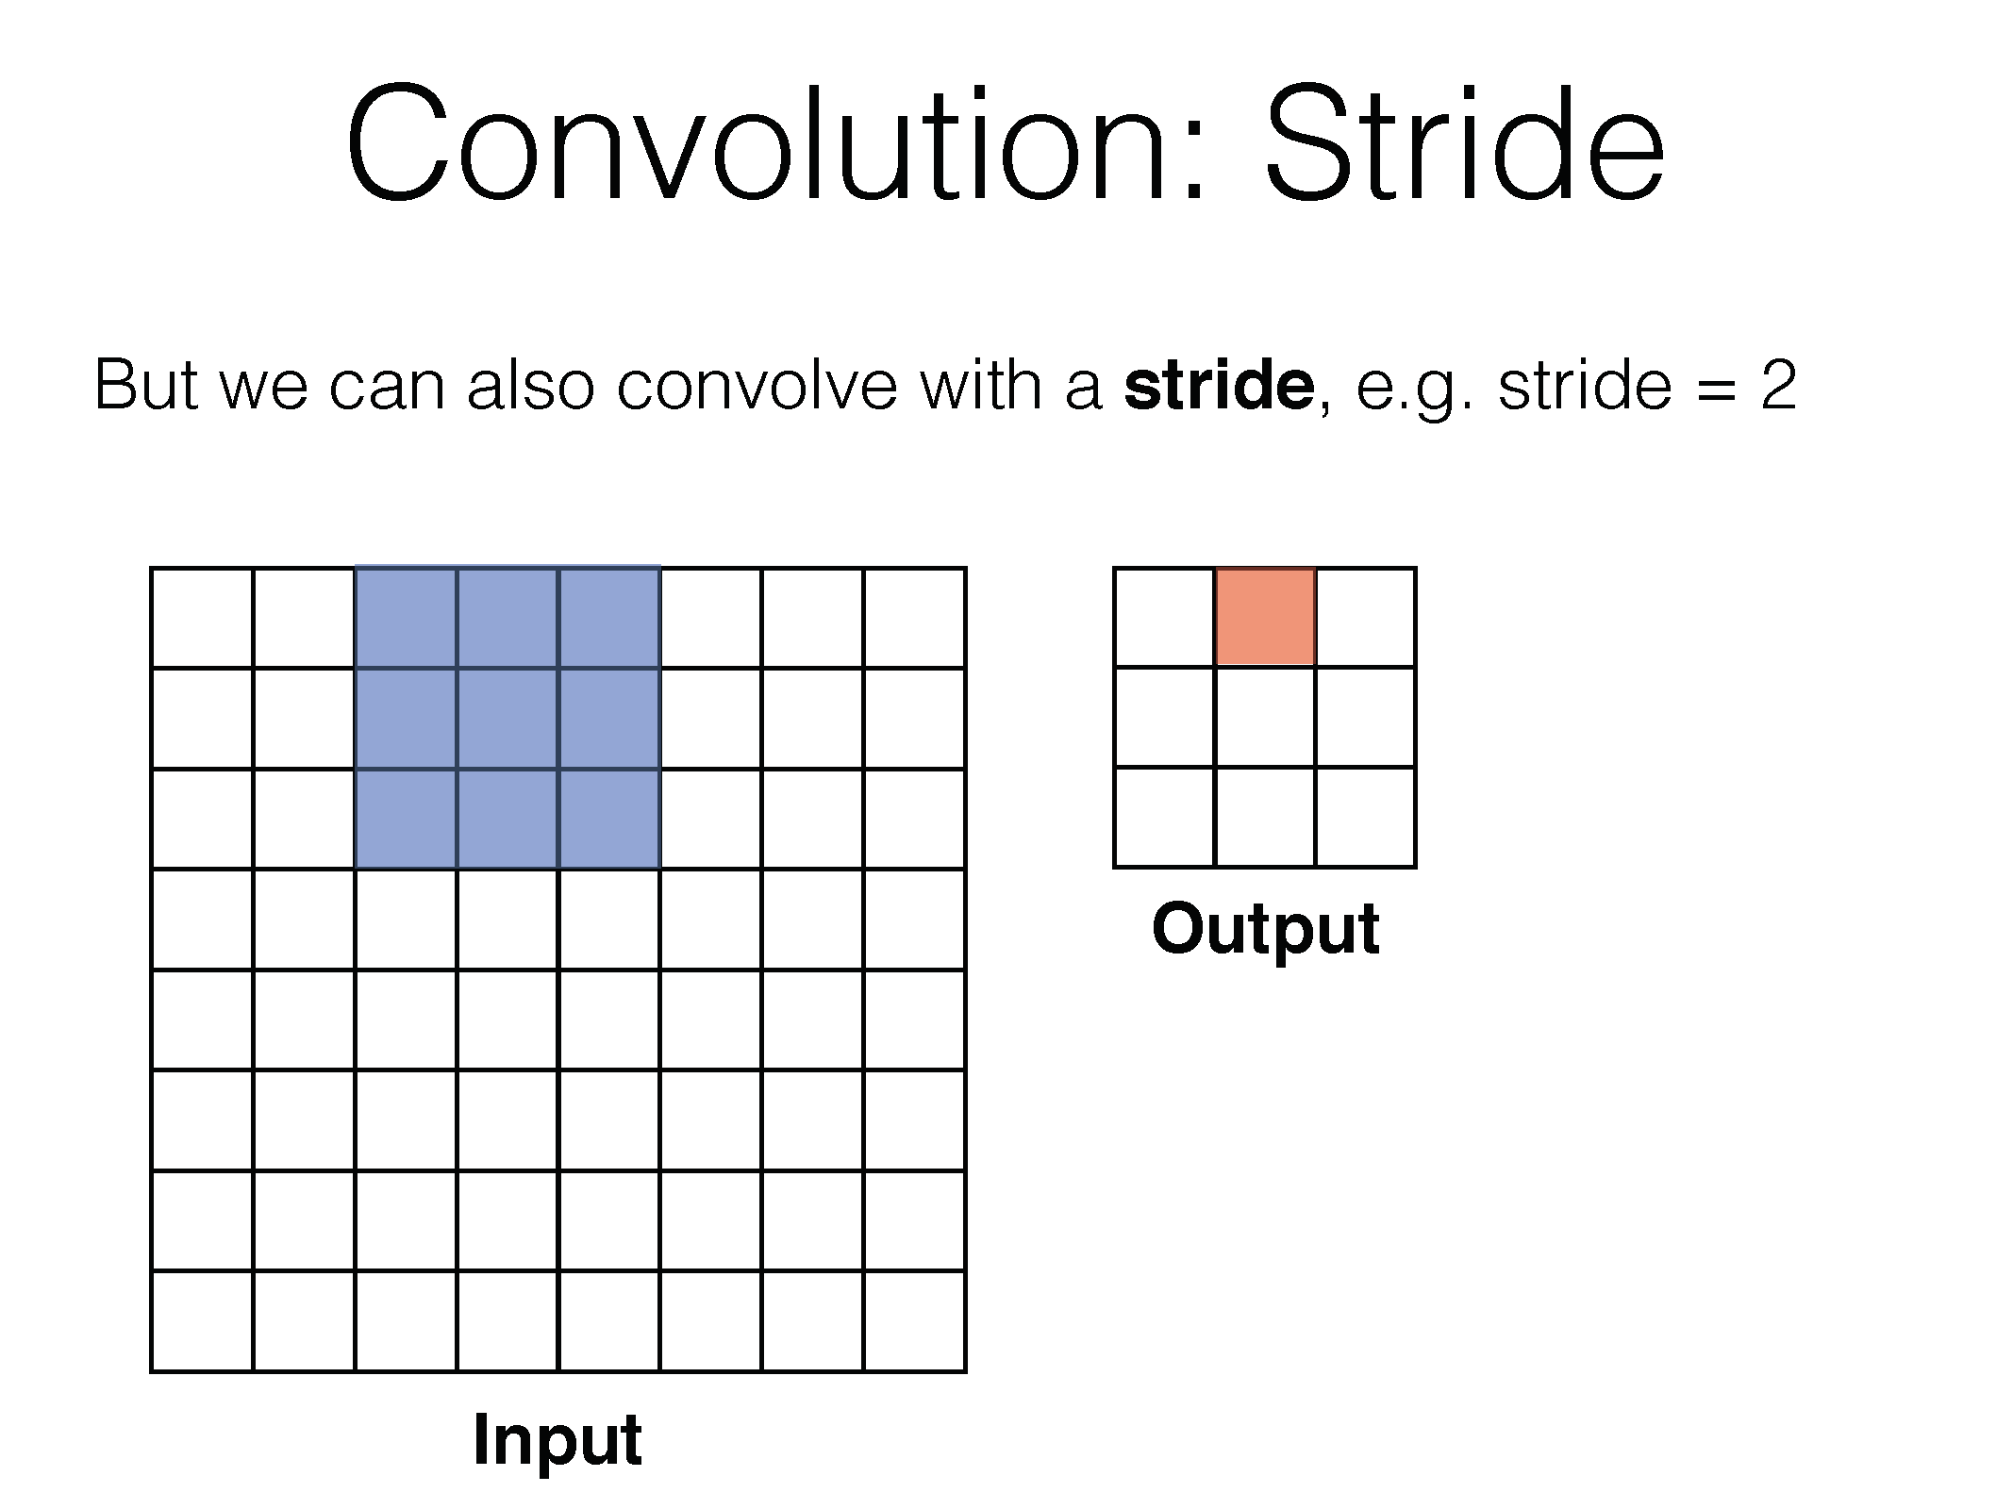

Slide 51
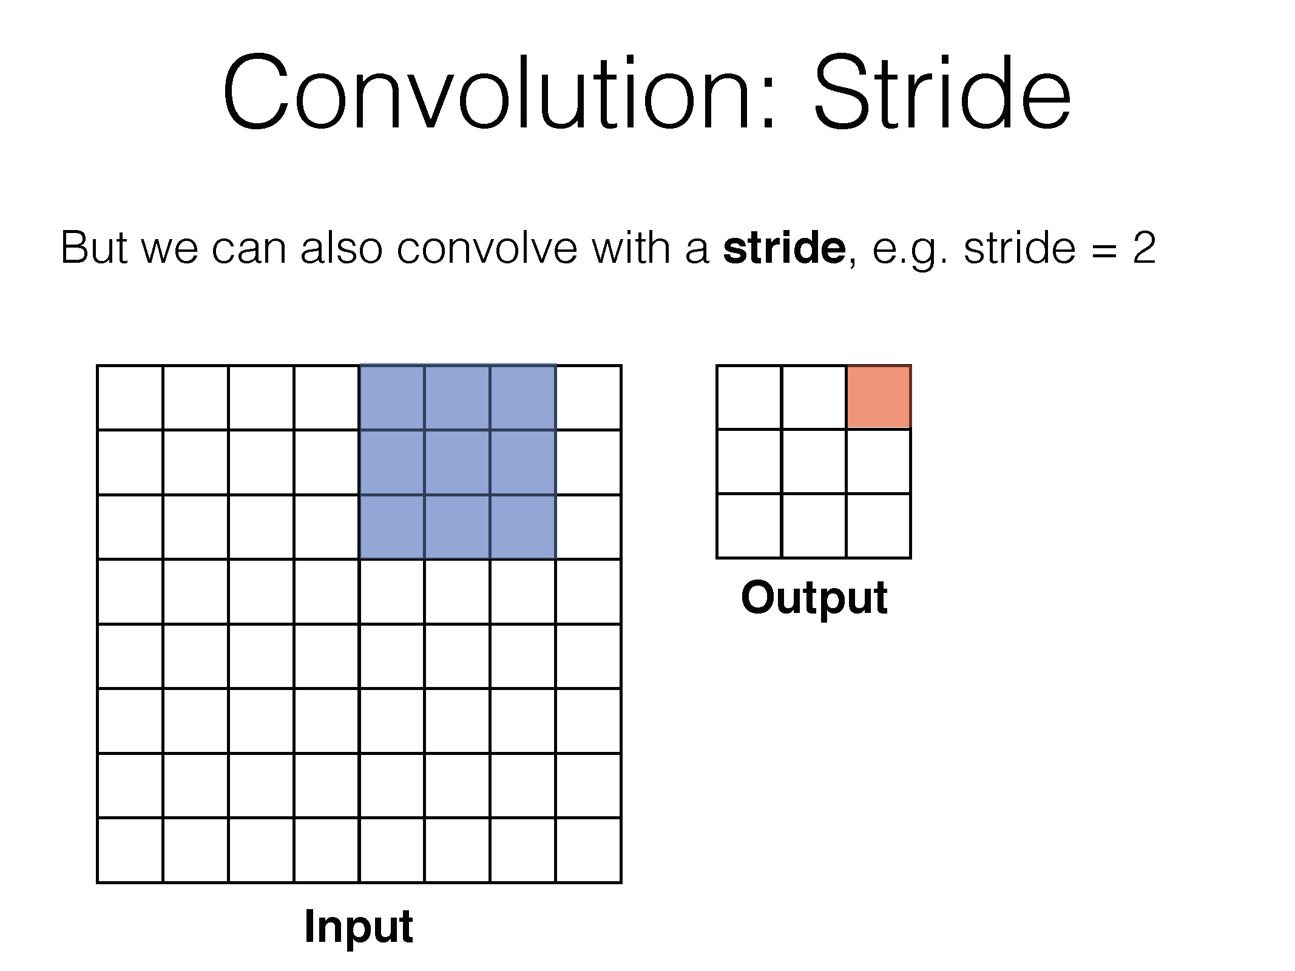

Slide 52
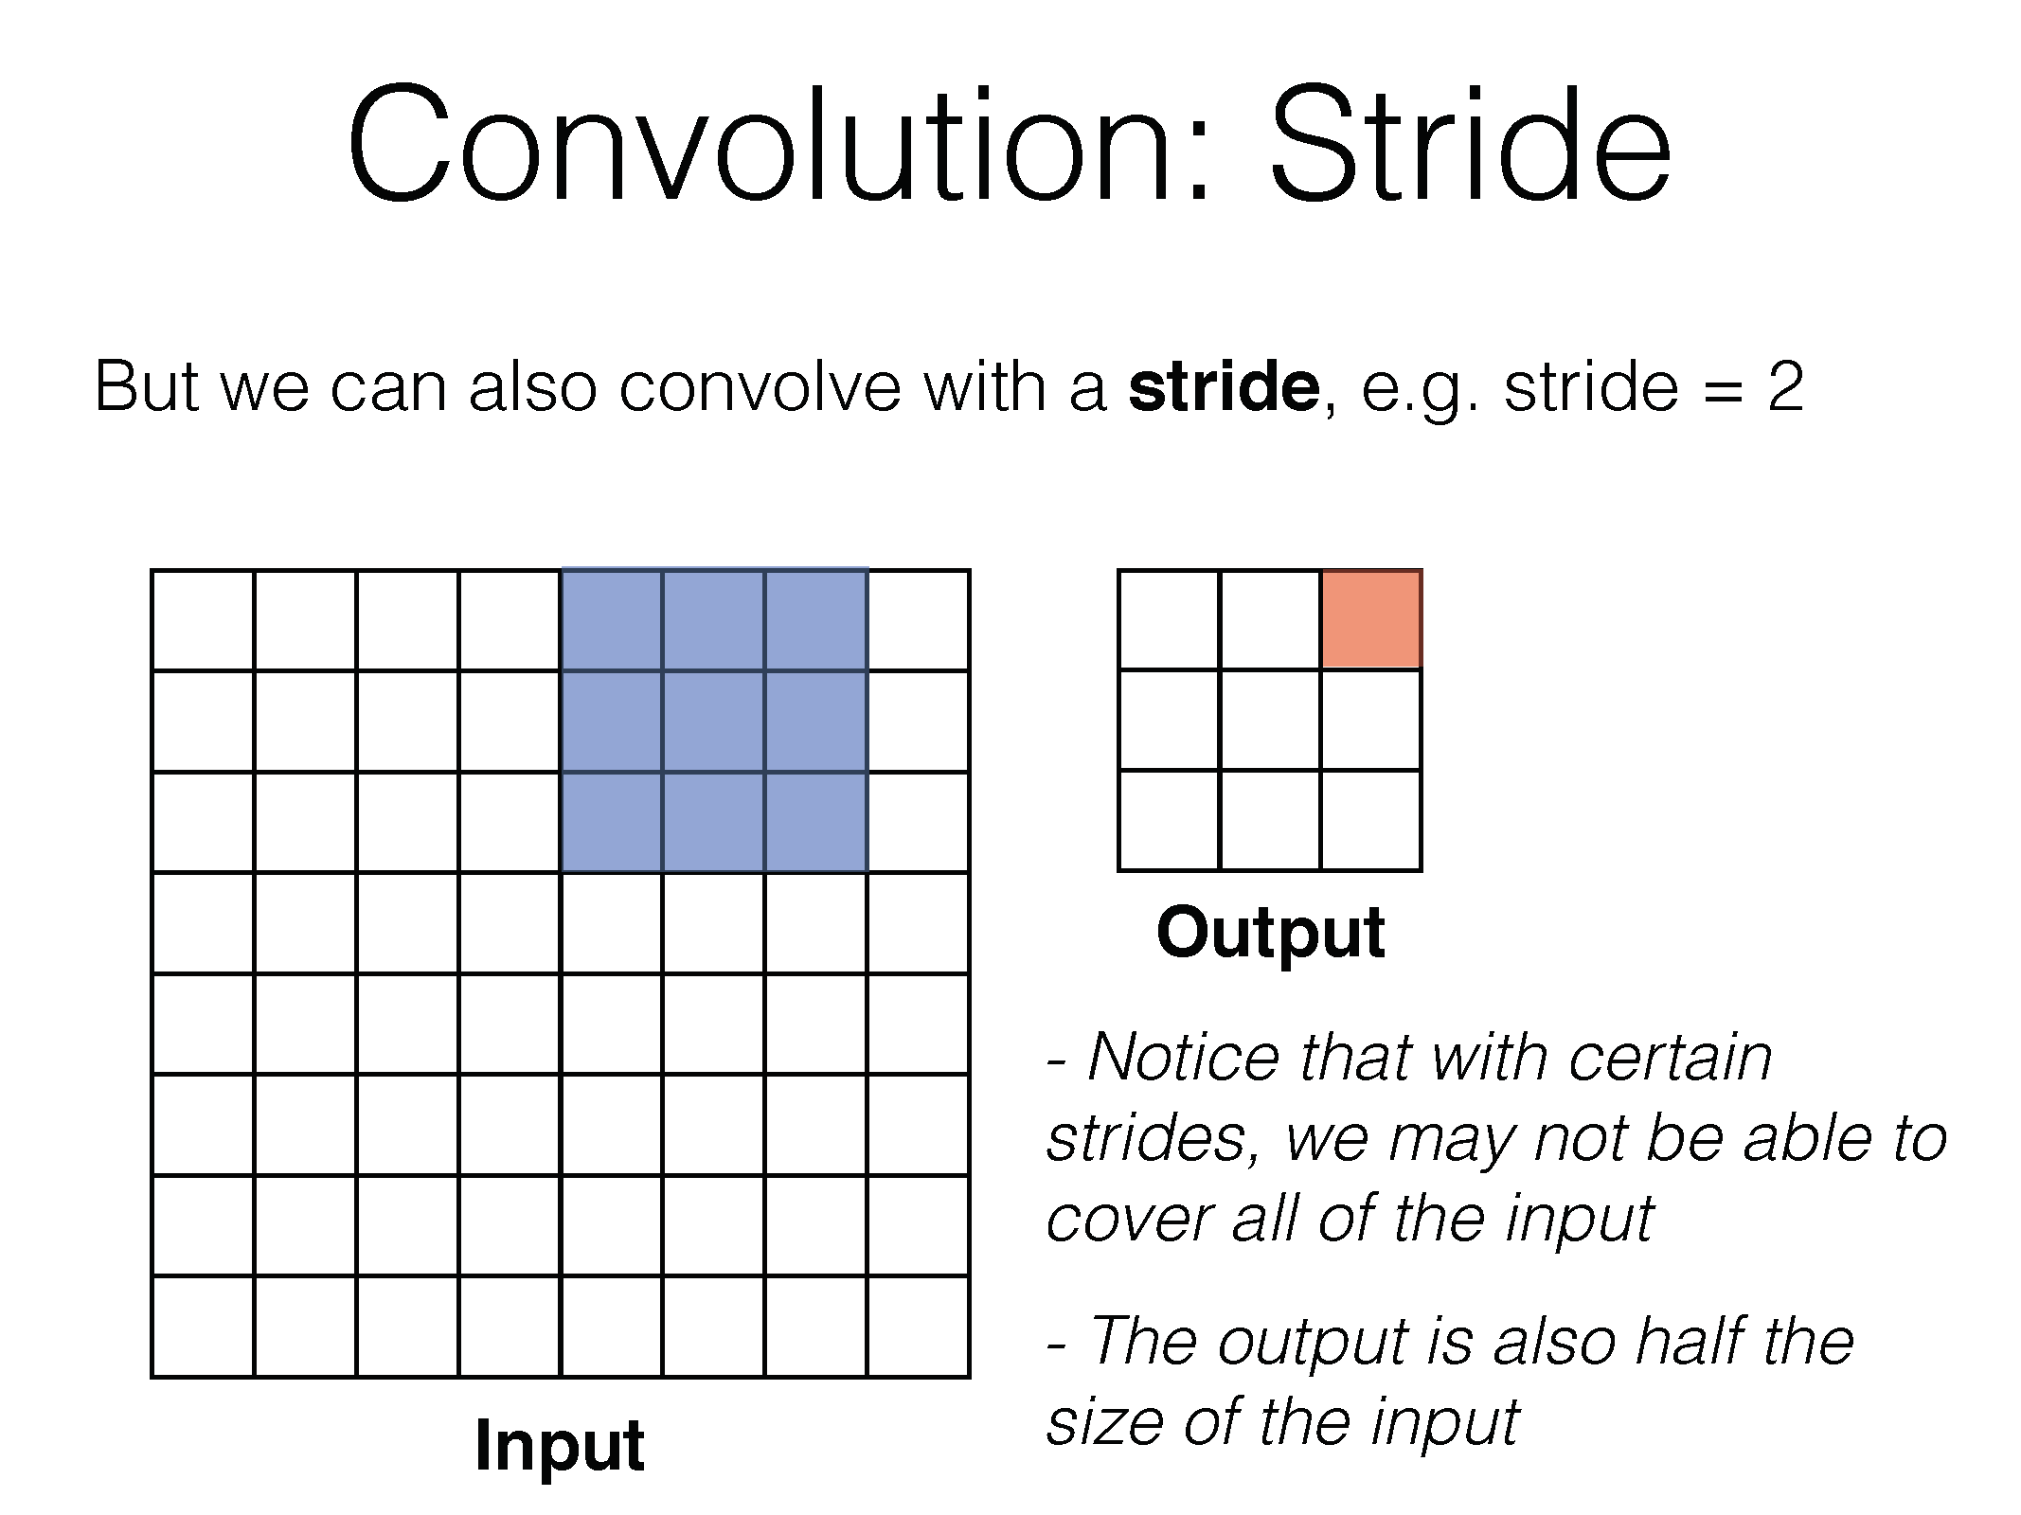

Slide 53
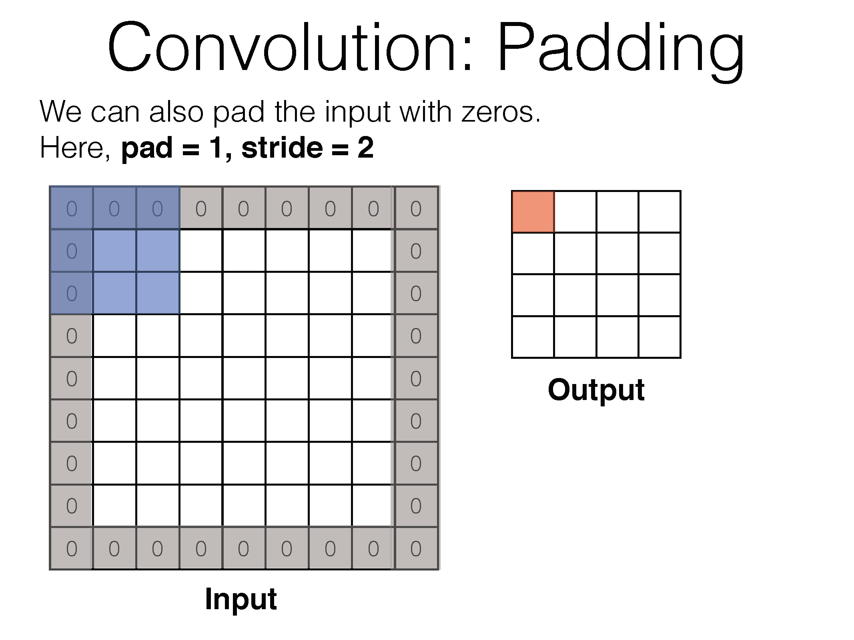

Slide 54
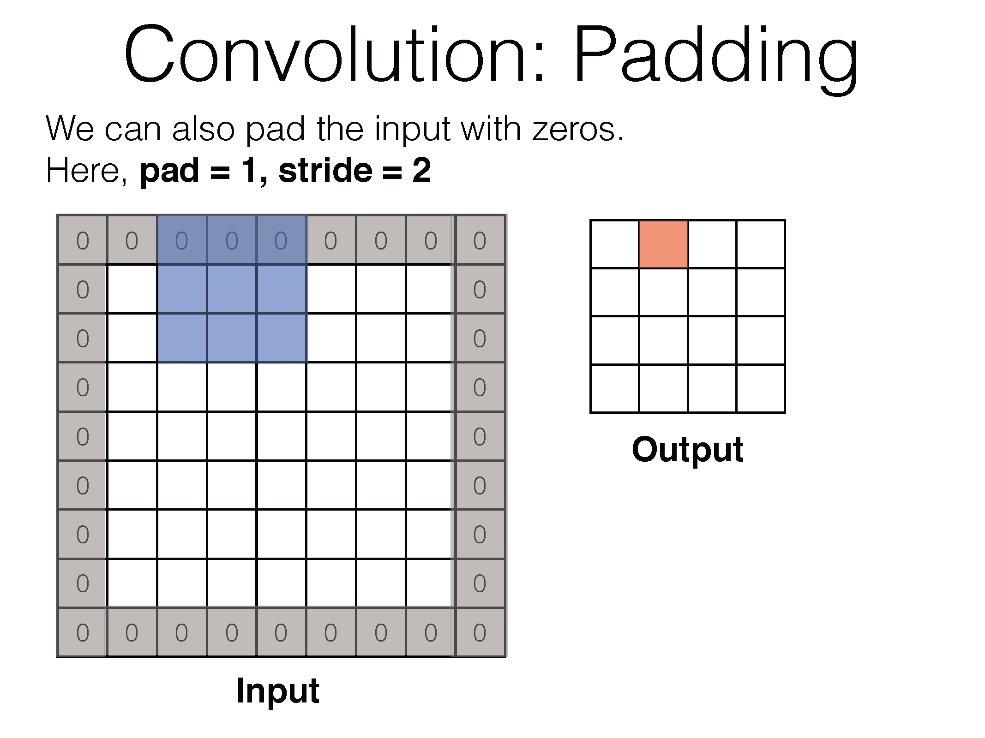

Slide 55
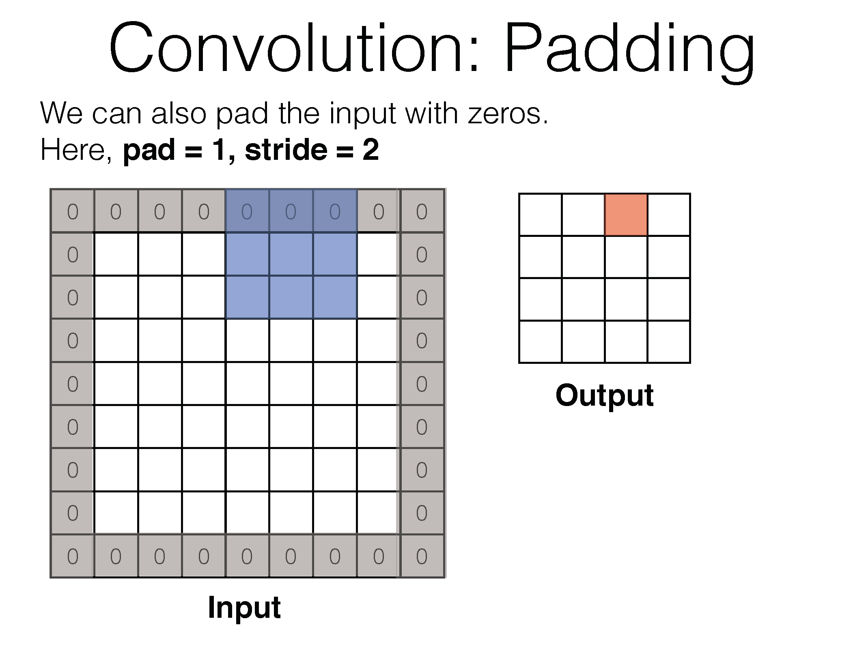

Slide 56
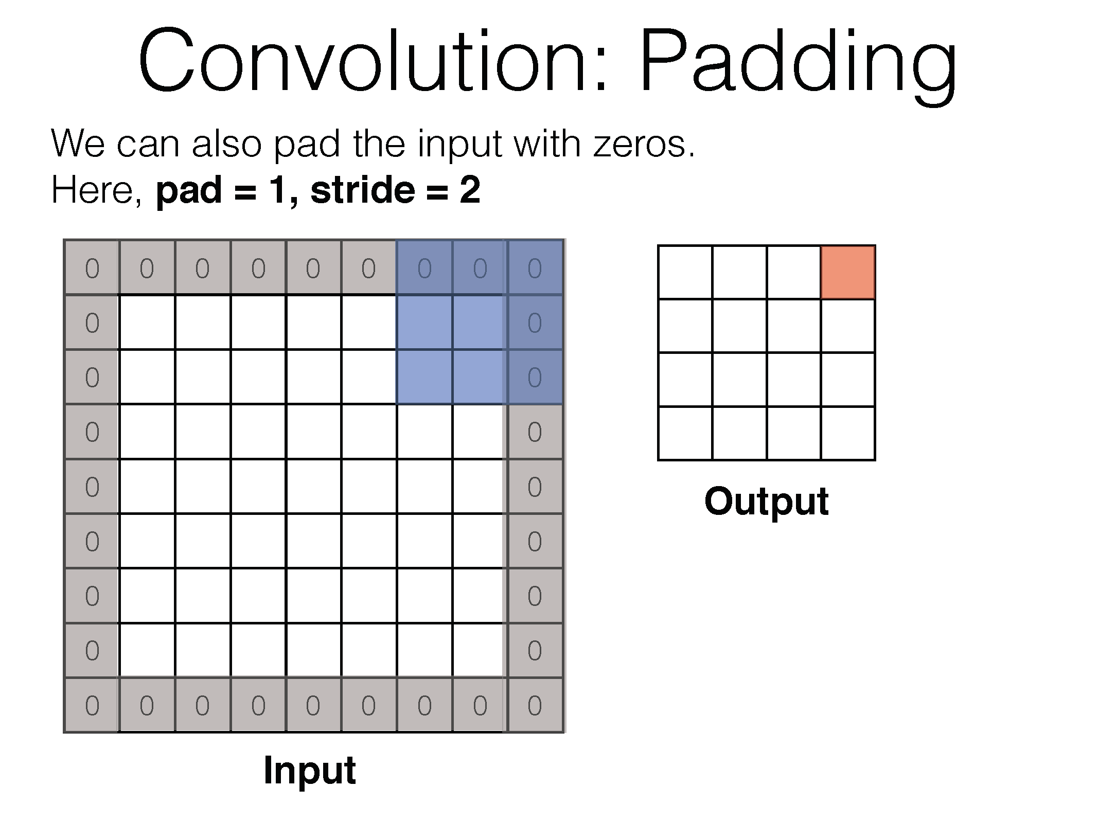

Slide 57
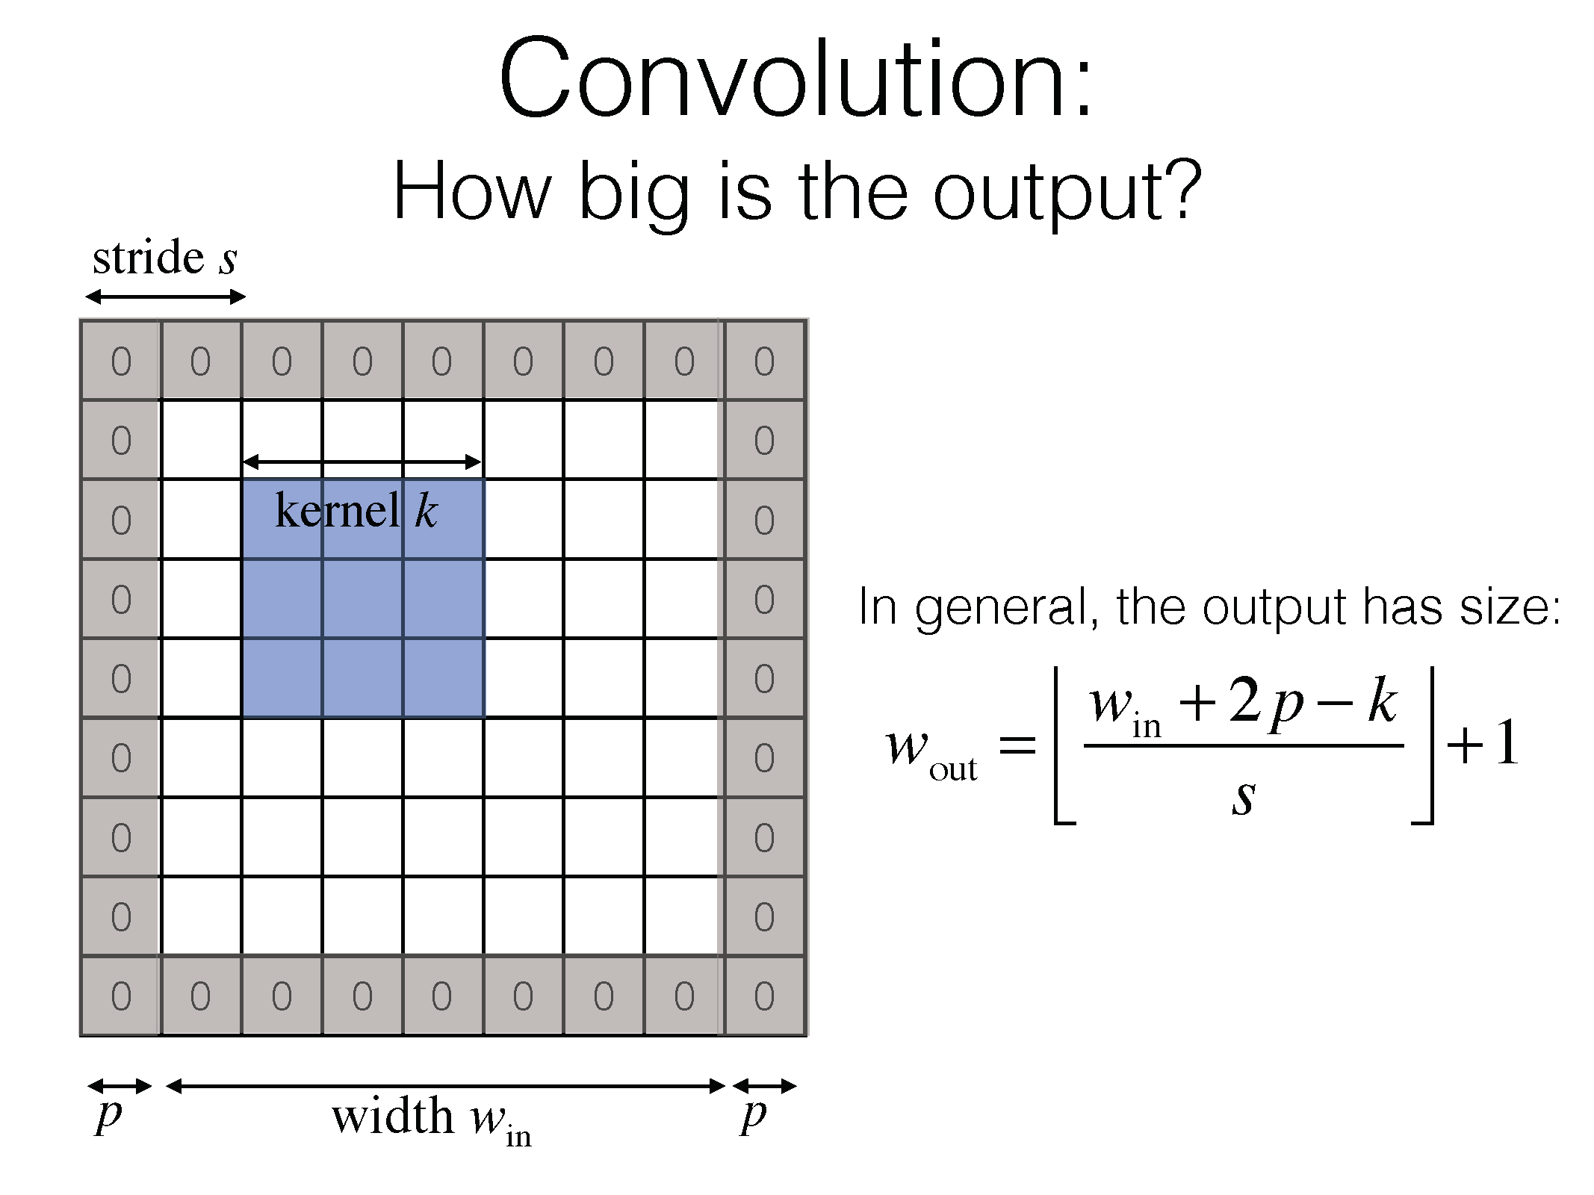
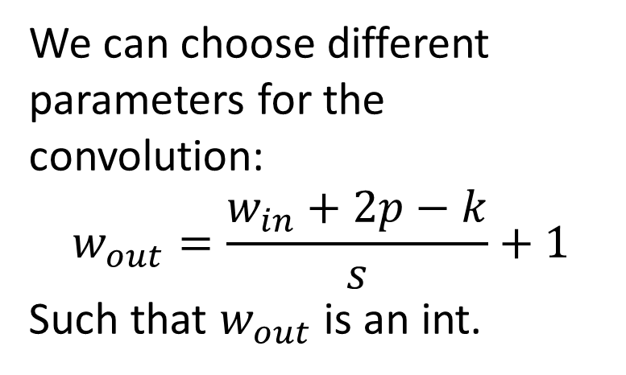
We can choose different parameters for the convolution:
$$w_{out}=\frac{w_{in}+2p−k}{s}+1$$
Such that $w_{out}$ is an int.

Slide 58
Stacking conv layers
What is better? One layer of 5x5 kernel or 2 layers of 3x3 kernel?

Slide 59
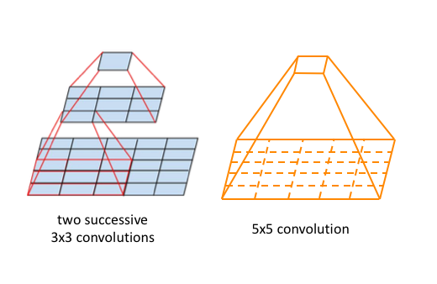
Stacking conv layers
What is better? One layer of 5x5 kernel or 2 layers of 3x3 kernel?
Their receptive fields are the same!

Slide 60
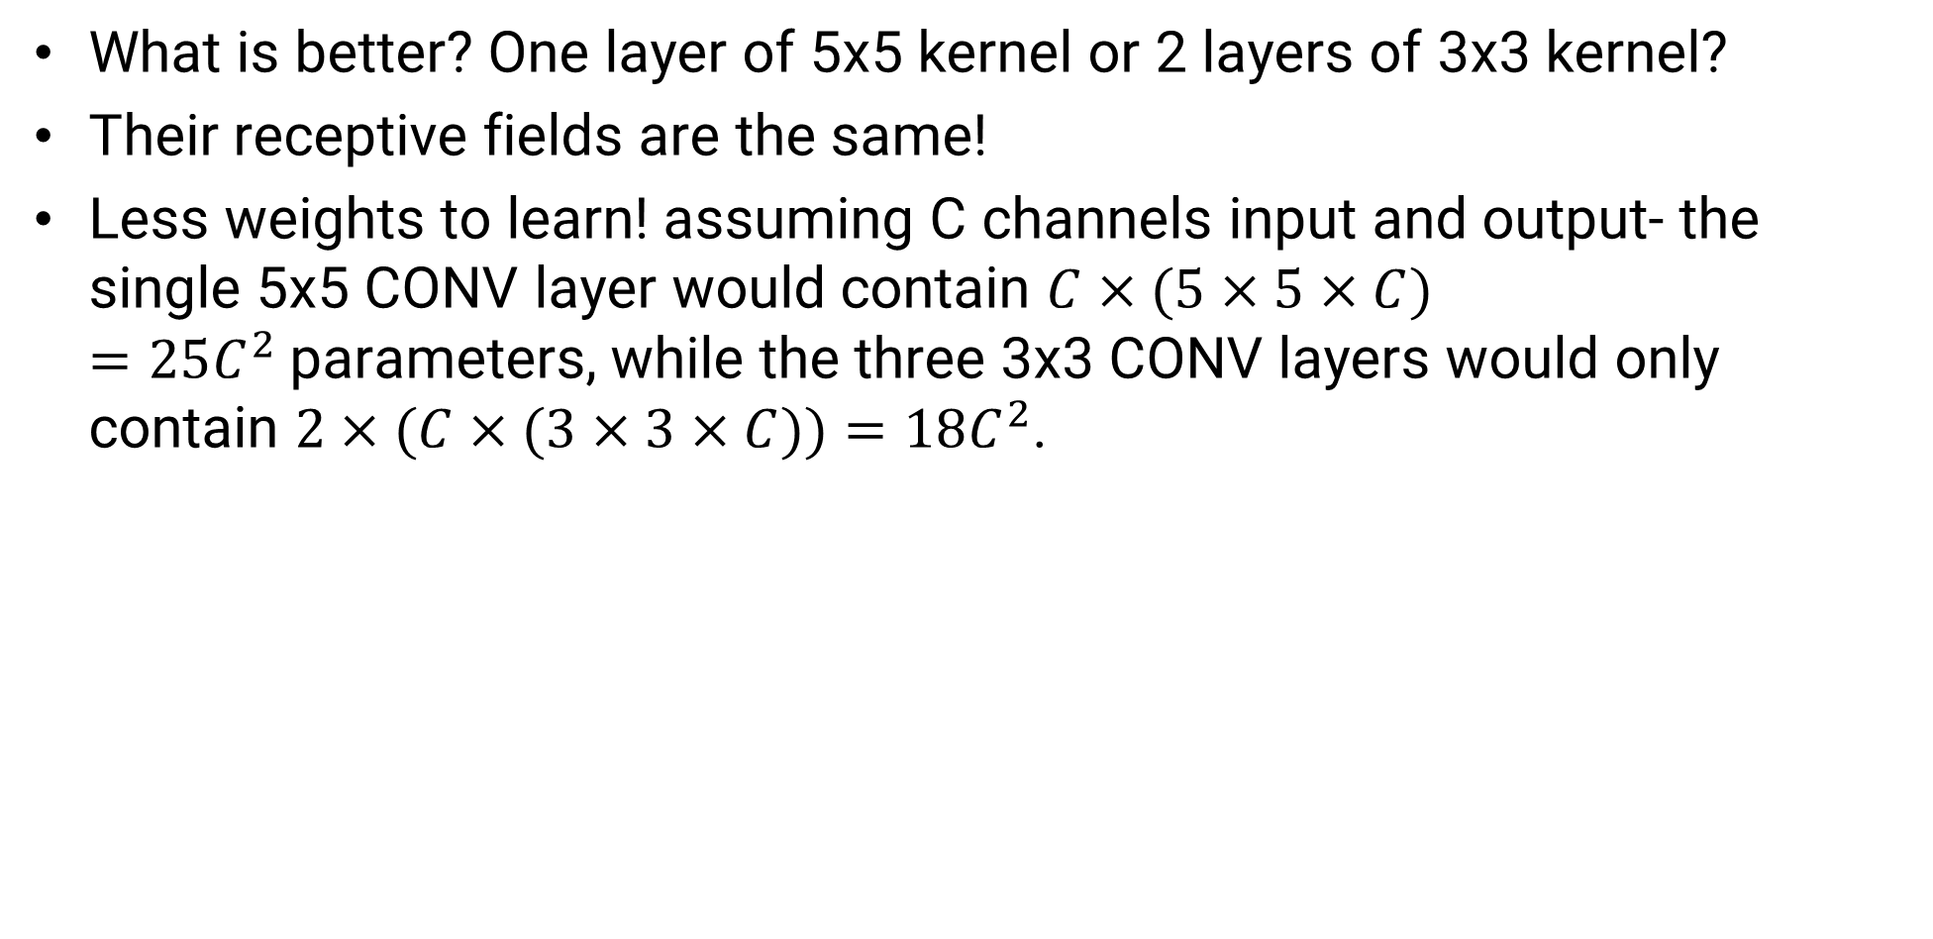
Stacking conv layers
What is better? One layer of 5x5 kernel or 2 layers of 3x3 kernel?
Their receptive fields are the same!
Less weights to learn! assuming C channels input and output- the single 5x5 CONV layer would contain $C×(5×5×C)=25C^{2}$parameters, while the three 3x3 CONV layers would only contain $2×(C×(3×3×C))=18C^{2}$.

Slide 61
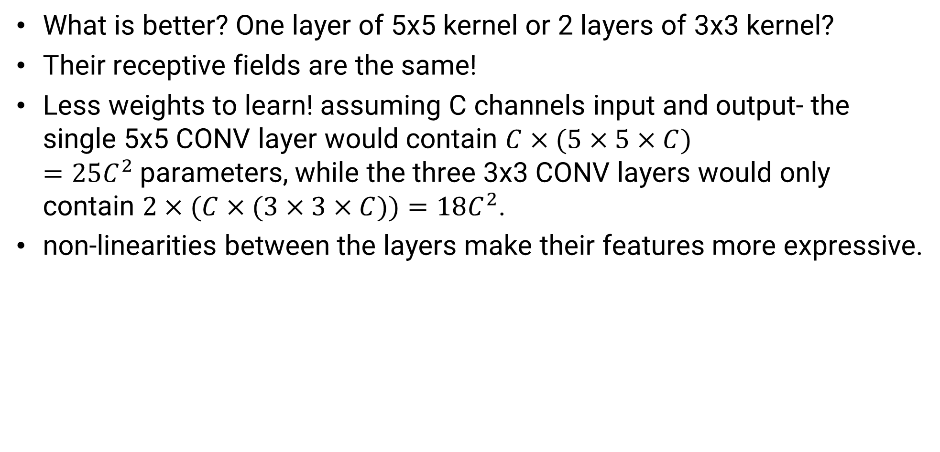
Stacking conv layers
What is better? One layer of 5x5 kernel or 2 layers of 3x3 kernel?
Their receptive fields are the same!
Less weights to learn! assuming C channels input and output- the single 5x5 CONV layer would contain $C×(5×5×C)=25C^{2}$parameters, while the three 3x3 CONV layers would only contain $2×(C×(3×3×C))=18C^{2}$.
non-linearities between the layers make their features more expressive.

Slide 62
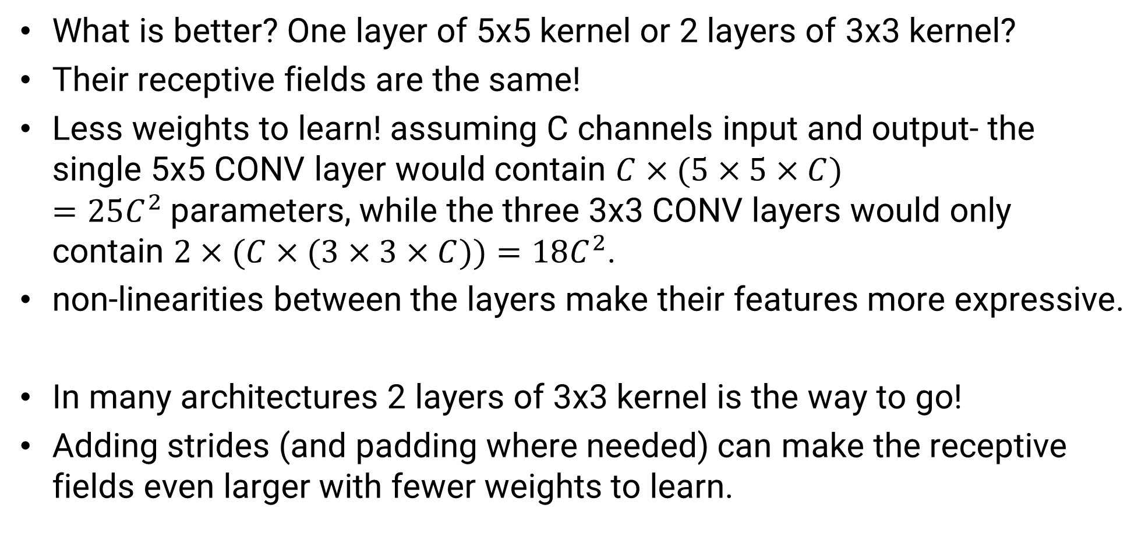
Stacking conv layers
What is better? One layer of 5x5 kernel or 2 layers of 3x3 kernel?
Their receptive fields are the same!
Less weights to learn! assuming C channels input and output- the single 5x5 CONV layer would contain $C×(5×5×C)=25C^{2}$parameters, while the three 3x3 CONV layers would only contain $2×(C×(3×3×C))=18C^{2}$.
non-linearities between the layers make their features more expressive.
In many architectures 2 layers of 3x3 kernel is the way to go!
Adding strides (and padding where needed) can make the receptive fields even larger with fewer weights to learn.

Slide 63
contents
Chain rule
ConvNets
Convolution layer
Pooling layer
Overfitting
Architectures
Alexnet (dropout)
VGG
ResNet (batch norm)

Slide 64
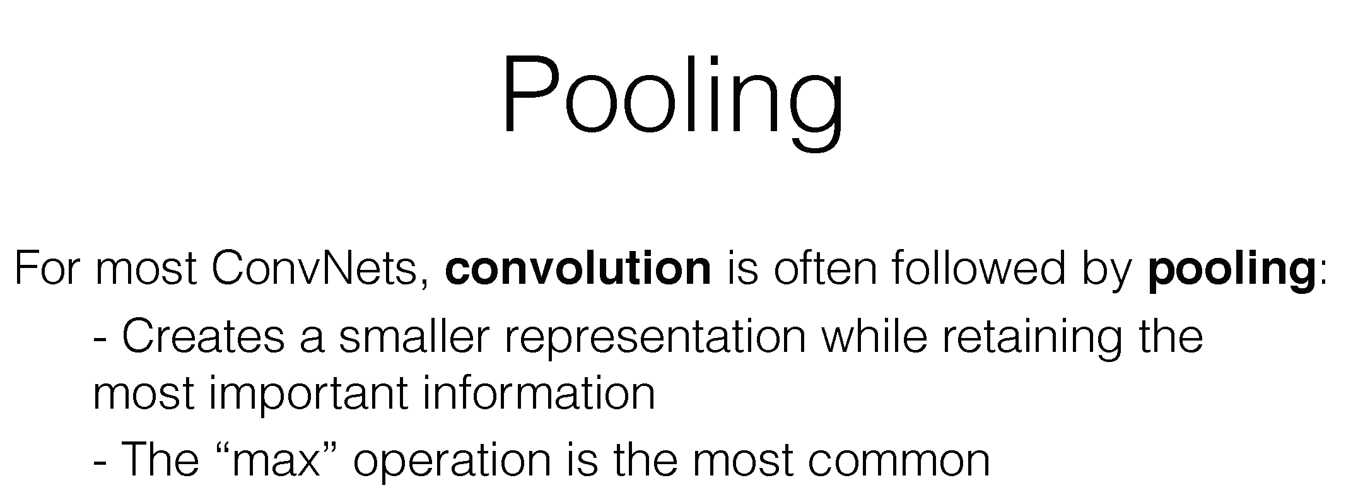

Slide 65
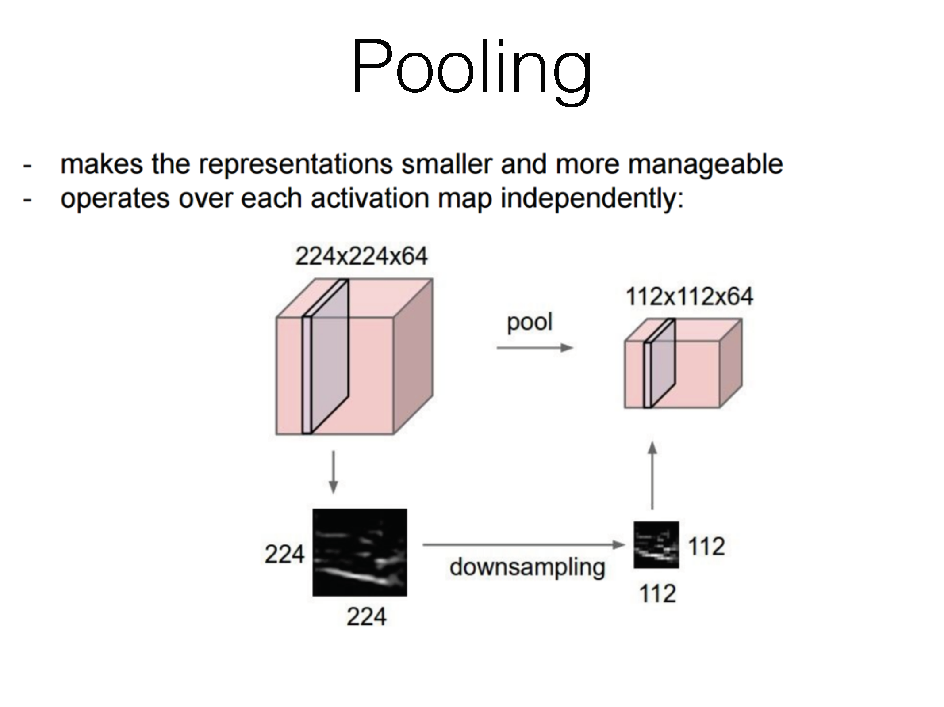

Slide 66


Slide 67


Slide 68
Layer depth
First layers detect simple patterns (colors, edges, etc.)
Deeper layers detects more complex patterns which is built upon the output of the first layers.
Great example:
https://www.youtube.com/watch?v=AgkfIQ4IGaM

Slide 69


Slide 70


Slide 71
Conv colab

Slide 72
contents
Chain rule
ConvNets
Convolution layer
Pooling layer
Overfitting
Architectures
Alexnet (dropout)
VGG
ResNet (batch norm)

Slide 73

Overfitting
Overfitting: analysis that corresponds too closely or exactly to a particular set of data and may therefore fail to fit additional data or predict future observations reliably.
Underfitting: insufficiently modeling the relationship of the data points.

Slide 74

Overfitting
Overfitting is one of the biggest problems in NN.
It is said that for a net to not overfit we need X10 data-samples as weights.
What to do when you don’t have millions of examples?
Example of trying to fit small dataset to a model with a lot of DOFs.

Slide 75





Remove outliers
Clean the data so that that its variance would be relatively small.
With a small dataset- even one outlier datapoint can be problematic.
bat
Also a bat – but not what we looked for

Slide 76

Augmentations
Technique used to increase the amount of data by adding slightly modified copies of already existing data
Examples: rotation, translation, scale, shear, brightness, contrast, noise, crop, warping etc…

Slide 77

Cross validation
Partitioning a sample of data into complementary subsets and validating the analysis on the other subset. Validation results are averaged over the rounds to give an estimate of the model's predictive performance.
The final step is to train the model on the entire dataset and by doing you get more training data because you don’t need a validation set.
Downside: training time is longer.

Slide 78
Transfer learning
Take a pretrained model on a larger similar dataset and train again a subset of its layers to your new dataset.
The idea is that the features learned in the first layers are still relevant to your data, and all you need is to train the more complex layers near the output to learn your new data.

Slide 79


Transfer learning

Slide 80
Overfitting- the upside
Overfitting isn’t always bad- there is a known trick to check the correctness of your NN: take a small batch of data and try intentionally to overfit it!
This will show you if you have any underlying problems in your net architecture before you start train.

Slide 81
contents
Chain rule
ConvNets
Convolution layer
Pooling layer
Overfitting
Architectures
Alexnet (dropout)
VGG
ResNet (batch norm)

Slide 82


Alexnet
The winner of the 2012 IMAGENET competition (classification % of top 5 out of 1000 labels).
224X224X3 input.
8 learnable layers.
61M parameters.

Slide 83

Alexnet
Interesting facts:
The first winner of IMAGENET who used NN- started the NN trend we are feeling now.
Not really used today.
Used dropout as a technique to avoid overfitting.

Slide 84

dropout
Neuron is dropped from the network with a probability of 0.5. When a neuron is dropped, it does not contribute to either forward or backward propagation.
Every input goes through a different network architecture, as a result, the learnt weight parameters are more robust.
During testing, there is no dropout and the whole network is used, but output is scaled by a factor of 0.5 to account for the missed neurons while training.
Dropout increases the number of iterations needed to converge by a factor of 2.

Slide 85

VGG16
Winner of IMAGENET 2014 classification challenge.
16 layers (there are also other variations with 11,13 and 19 layers).
138M parameters.
Used small receptive fields with stacked conv layers (shown before)- compared to 11X11 and 5X5 in AlexNet, her there is only 3X3 layers.
Still in use today!

Slide 86

ResNet
Winner of IMAGENET 2015 classification challenge.
152 layers (there are also other variations with 18,34,50 and 101 layers).
60M parameters (<0.5X VGG16!!!).
Still in use today!

Slide 87

ResNet
Interesting blocks:
Batch norm (for vanishing gradient problem).
Residual block (for train accuracy degradation) – out of scope.

Slide 88
Vanishing gradient

